Slide 1

Modeling and Analyzing IVR Systems,
as a Special Case of Self-services
Nitzan Carmeli
Advisors: Prof. Haya Kaspi, Prof. Avishai Mandelbaum
Industrial Engineering and Management
Technion
Thesis Exam
3.5.2015
1

Slide 2
Introduction Literature Review Research Goals Search Model MDP Case Study Model Implications Summary
Introduction
Call Center with an IVR system
IVR
?
Success
?
Abandonment
P
Agents
Returns
2

Slide 3
Introduction Literature Review Research Goals Search Model MDP Case Study Model Implications Summary
Literature Review
Methodologies for evaluating IVRs
  Quantifying IVR usability and cost-effectiveness
    Agent time being saved by handling the call, or part of the call, in the IVR
    Original reasons for calling vs. experience
    (by analyzing end-to-end calls)
    Suhm B. and Peterson P. (2002, 2009)
3

Slide 4
Introduction Literature Review Research Goals Search Model MDP Case Study Model Implications Summary
Literature Review
Methodologies for evaluating IVRs
  Quantifying IVR usability and cost-effectiveness
    Agent time being saved by handling the call, or part of the call, in the IVR
    Original reasons for calling vs. experience
    (by analyzing end-to-end calls)
    Suhm B. and Peterson P. (2002, 2009)
Designing and optimizing IVRs
  Human-Factor-Engineering
    Mainly comparing broad (shallow) designs and narrow (deep) designs.
  Examples: Schumacher R. et al. (1995), Commarford P. et al. (2008) and many more.
30% completed service in IVR
Only 1.6% completed it successfully
3

Slide 5
Introduction Literature Review Research Goals Search Model MDP Case Study Model Implications Summary
Literature Review
Broad (shallow) design:
Narrow (deep) design:
0
0
6
5
4
3
2
1
1
2
3
4
6
5
4

Slide 6
Introduction Literature Review Research Goals Search Model MDP Case Study Model Implications Summary
Literature Review
Reducing IVR service times
  The IVR menu as a service tree –
  reducing the average time to reach a desired service
    Salcedo-Sanz S. et al. (2010)
Stochastic search in a Forest
  Models of stochastic search in the context of R&D projects
  Optimality of index policy.
  Denardo E.V., Rotblum U.G., Van der Heyden L. (2004)
  Granot D. and Zuckerman D. (1991)
5

Slide 7
Introduction Literature Review Research Goals Search Model MDP Case Study Model Implications Summary
Research Goals
Improving and enhancing IVR system as a special case of self-services,
via
Modeling customer flow within an IVR system
Using EDA to estimate model parameters and identify usability
problems: has actually inspired our theoretical model
Using optimal search solutions and empirical analysis to compare
alternative designs and infer design implications
6

Slide 8
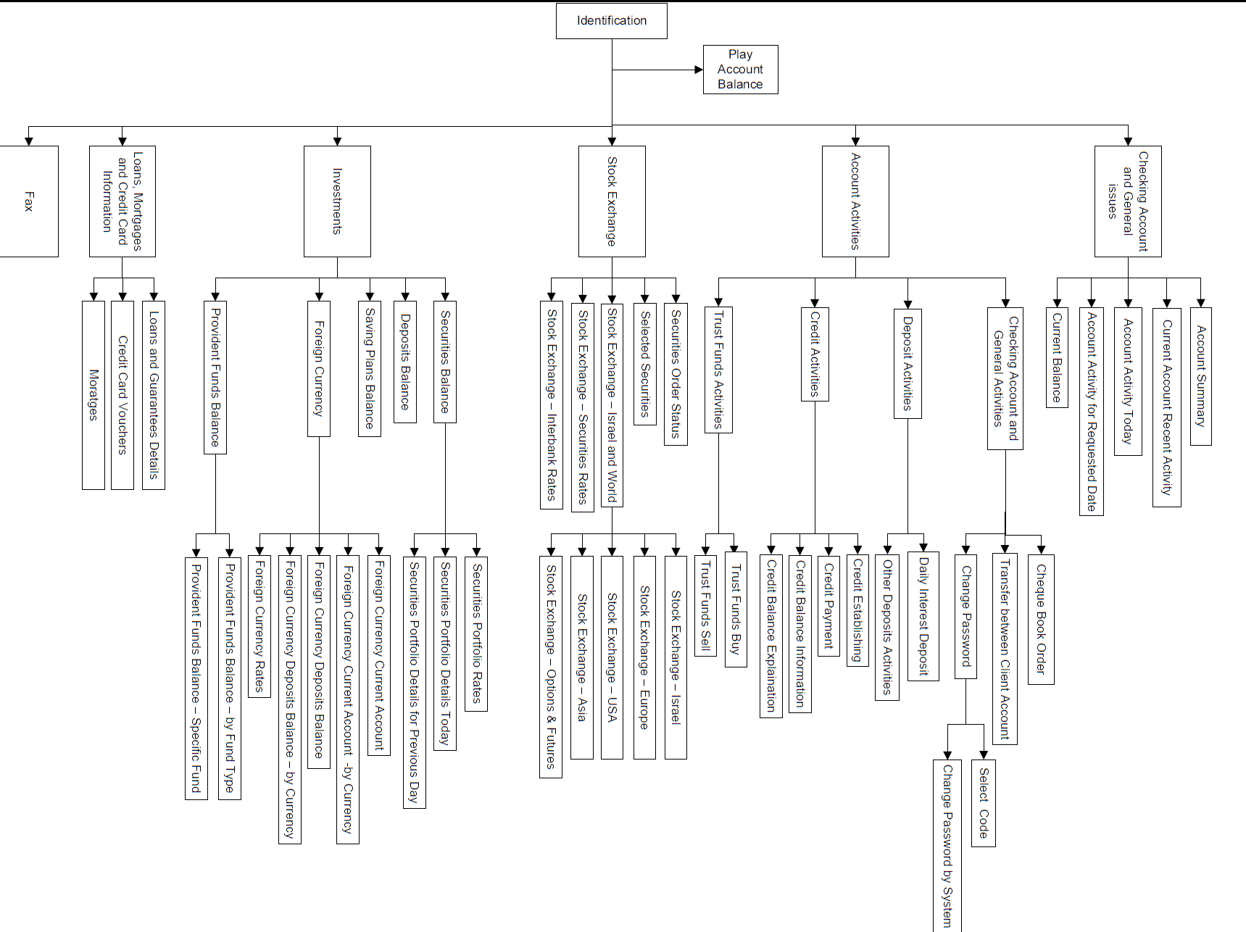
Introduction Literature Review Research Goals Search Model MDP Case Study Model Implications Summary
Search Model
Adapted from an actual IVR of a commercial enterprise
7

Slide 9
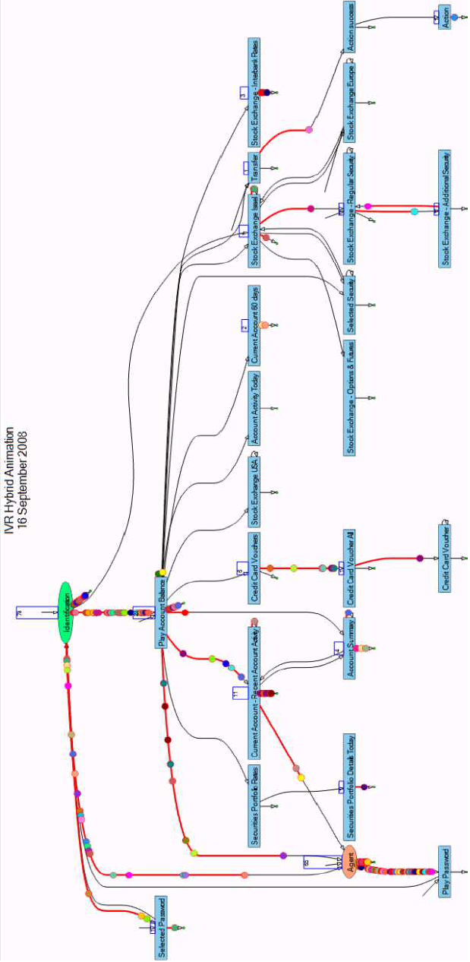
Introduction Literature Review Research Goals Search Model MDP Case Study Model Implications Summary
Search Model
Hybrid Animation
Network Animation
8

Slide 10
Introduction Literature Review Research Goals Search Model MDP Case Study Model Implications Summary
Search Model
Notations
s
b
a
e
d
c
g
f
9

Slide 11
Introduction Literature Review Research Goals Search Model MDP Case Study Model Implications Summary
Search Model
Notations
s
b
a
e
d
c
g
f
9

Slide 12
Introduction Literature Review Research Goals Search Model MDP Case Study Model Implications Summary
Search Model
Notations
s
b
a
e
d
c
g
f
9

Slide 13
Introduction Literature Review Research Goals Search Model MDP Case Study Model Implications Summary
Search Model
Notations
s
b
a
e
d
c
g
f
9

Slide 14
Introduction Literature Review Research Goals Search Model MDP Case Study Model Implications Summary
Search Model
Notations
s
b
a
e
d
c
g
f
9

Slide 15
Introduction Literature Review Research Goals Search Model MDP Case Study Model Implications Summary
Search Model
Customer search
  Customers pay for each unit of time they spend in the IVR
  Customers receive reward when reaching a desired service
  Customers may look for more than one service
  Customers have finite patience,
10

Slide 16
Introduction Literature Review Research Goals Search Model MDP Case Study Model Implications Summary
Search Model
Customer search
  At each stage the customer can choose:
  Terminate the search and leave the system
s
b
a
e
d
c
g
f
11

Slide 17
Introduction Literature Review Research Goals Search Model MDP Case Study Model Implications Summary
Search Model
Customer search
  At each stage the customer can choose:
  Terminate the search and leave the system
  Terminate the search and opt-out to an agent
s
opt-out
b
a
opt-out
e
d
c
opt-out
g
f
11

Slide 18
Introduction Literature Review Research Goals Search Model MDP Case Study Model Implications Summary
Search Model
Customer search
  At each stage the customer can choose:
  Terminate the search and leave the system
  Terminate the search and opt-out to an agent
  Move forward to one of i’s immediate successors,
s
opt-out
b
a
opt-out
e
d
c
opt-out
g
f
11

Slide 19
Introduction Literature Review Research Goals Search Model MDP Case Study Model Implications Summary
Search Model
Customer search
  At each stage the customer can choose:
  Terminate the search and leave the system
  Terminate the search and opt-out to an agent
  Move forward to one of i’s immediate successors,
  Move backward to i’s immediate predecessor,
s
opt-out
b
a
opt-out
e
d
c
opt-out
g
f
11

Slide 20
Introduction Literature Review Research Goals Search Model MDP Case Study Model Implications Summary
Search Model
Customer search
  At each stage the customer can choose:
  Terminate the search and leave the system
  Terminate the search and opt-out to an agent
  Move forward to one of i’s immediate successors,
  Move backward to i’s immediate predecessor,
  Move backward to the root vertex,
s
opt-out
b
a
opt-out
e
d
c
opt-out
g
f
11

Slide 21
Introduction Literature Review Research Goals Search Model MDP Case Study Model Implications Summary
Search Model
States
Additional parameters
i
l_{i}
j
k
13

Slide 22
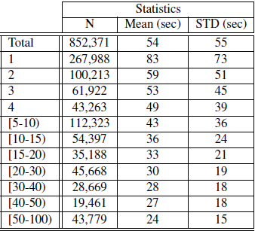
Introduction Literature Review Research Goals Search Model MDP Case Study Model Implications Summary
Search Model
14

Slide 23
Introduction Literature Review Research Goals Search Model MDP Case Study Model Implications Summary
Search Model
Search candidates
s
b
a
e
d
c
g
f
15

Slide 24
Introduction Literature Review Research Goals Search Model MDP Case Study Model Implications Summary
Search Model
Search candidates
s
b
a
e
d
c
g
f
15

Slide 25
Introduction Literature Review Research Goals Search Model MDP Case Study Model Implications Summary
Search Model
Search candidates
s
b
a
e
d
c
g
f
15

Slide 26
Introduction Literature Review Research Goals Search Model MDP Case Study Model Implications Summary
Search Model
Search candidates
s
b
a
e
d
c
g
f
15

Slide 27
Introduction Literature Review Research Goals Search Model MDP Case Study Model Implications Summary
Search Model
Search candidates
s
b
a
e
d
c
g
f
15

Slide 28
Introduction Literature Review Research Goals Search Model MDP Case Study Model Implications Summary
Search Model
Search candidates
s
b
a
e
d
c
g
f
15

Slide 29
Introduction Literature Review Research Goals Search Model MDP Case Study Model Implications Summary
Search Model
Search candidates
s
b
a
e
d
c
g
f
15

Slide 30
Introduction Literature Review Research Goals Search Model MDP Case Study Model Implications Summary
Search Model
Search candidates
s
b
a
e
d
c
g
f
15

Slide 31
Introduction Literature Review Research Goals Search Model MDP Case Study Model Implications Summary
Search Model
Search candidates
16

Slide 32
Introduction Literature Review Research Goals Search Model MDP Case Study Model Implications Summary
Search Model
Search candidates
17

Slide 33
Introduction Literature Review Research Goals Search Model MDP Case Study Model Implications Summary
Search Model
Search candidates
17

Slide 34
Introduction Literature Review Research Goals Search Model MDP Case Study Model Implications Summary
Search Model
Search candidates
18

Slide 35
Introduction Literature Review Research Goals Search Model MDP Case Study Model Implications Summary
Search Model
Search candidates
19

Slide 36








Introduction Literature Review Research Goals Search Model MDP Case Study Model Implications Summary
Search Model
Admissible Tree Algorithm
20

Slide 37








Introduction Literature Review Research Goals Search Model MDP Case Study Model Implications Summary
Search Model
Admissible Tree Algorithm
21

Slide 38









Introduction Literature Review Research Goals Search Model MDP Case Study Model Implications Summary
Search Model
Admissible Tree Algorithm
21

Slide 39


Introduction Literature Review Research Goals Search Model MDP Case Study Model Implications Summary
Search Model
Admissible Tree Algorithm
21

Slide 40













Introduction Literature Review Research Goals Search Model MDP Case Study Model Implications Summary
Search Model
Admissible Tree Algorithm
21

Slide 41
Introduction Literature Review Research Goals Search Model MDP Case Study Model Implications Summary
Search Model
22

Slide 42
Introduction Literature Review Research Goals Search Model MDP Case Study Model Implications Summary
MDP
Backward induction – Index calculation
23

Slide 43
Introduction Literature Review Research Goals Search Model MDP Case Study Model Implications Summary
MDP
Backward induction – Index calculation
23

Slide 44
Introduction Literature Review Research Goals Search Model MDP Case Study Model Implications Summary
MDP
Backward induction – Index calculation
23

Slide 45
Introduction Literature Review Research Goals Search Model MDP Case Study Model Implications Summary
MDP
Backward induction – Index calculation
23

Slide 46
Introduction Literature Review Research Goals Search Model MDP Case Study Model Implications Summary
MDP
Backward induction – Index calculation
24

Slide 47
Introduction Literature Review Research Goals Search Model MDP Case Study Model Implications Summary
MDP
Backward induction – Index calculation
24

Slide 48
Introduction Literature Review Research Goals Search Model MDP Case Study Model Implications Summary
MDP
Backward induction – Index calculation
  At every stage we choose the edge with the highest index and
  calculate the expected revenue of its source vertex accordingly.
  If , and the highest index is smaller than :
  If , and the highest index is smaller than 0:
25

Slide 49
Introduction Literature Review Research Goals Search Model MDP Case Study Model Implications Summary
MDP
26

Slide 50
Introduction Literature Review Research Goals Search Model MDP Case Study Model Implications Summary
MDP
26

Slide 51
Introduction Literature Review Research Goals Search Model MDP Case Study Model Implications Summary
MDP
26

Slide 52
Introduction Literature Review Research Goals Search Model MDP Case Study Model Implications Summary
Introduction Literature Review Theoretical Model Empirical Analysis Model Implications Summary and Discussion
System Description
Case Study
A medium bank
About 450 working agents per day (~200 during peak hours)
Call by call data from May 1st, 2008 to June 30th, 2009
Overall Summary of calls
IVR Calls | Total | % Out of total | Average per weekday
# Served only by IVR | 27,709,543 | 61.6% | 50,937
# Requesting agent service | 17,280,159 | 38.4% | 31,765
27

Slide 53
Introduction Literature Review Research Goals Search Model MDP Case Study Model Implications Summary
Introduction Literature Review Theoretical Model Empirical Analysis Model Implications Summary and Discussion
System Description
Case Study
A large Israeli bank
About 450 working agents per day (~200 during peak hours)
Call by call data from May 1st, 2008 to June 30th, 2009
Overall Summary of calls
IVR Calls | Total | % Out of total | Average per weekday
# Served only by IVR | 27,709,543 | 61.6% | 50,937
# Requesting agent service | 17,280,159 | 38.4% | 31,765
10% of IVR calls – Identification only!
27

Slide 54
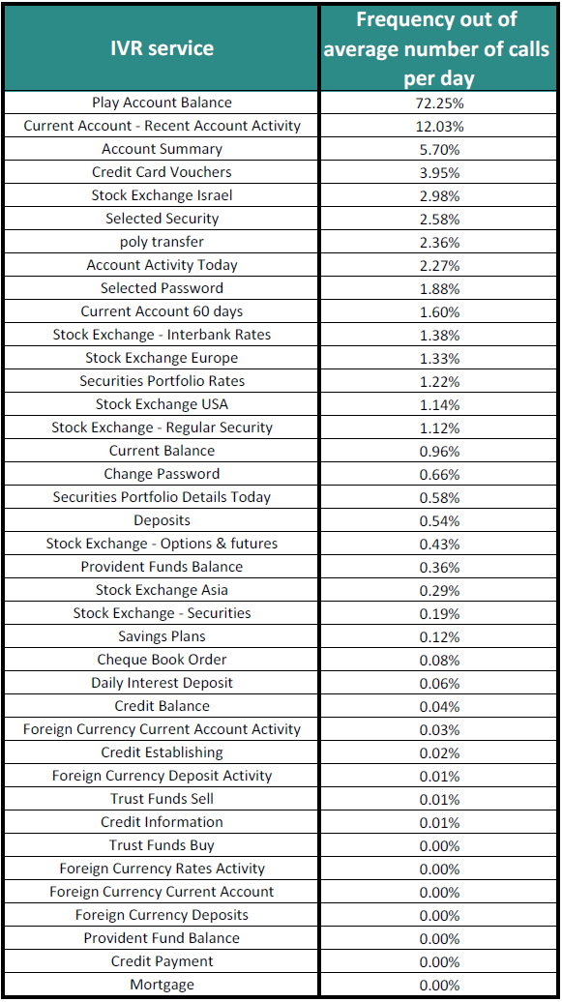
Introduction Literature Review Research Goals Search Model MDP Case Study Model Implications Summary
Case Study
28

Slide 55
Introduction Literature Review Research Goals Search Model MDP Case Study Model Implications Summary
Case Study
Requested by less than 2% of the calls
28

Slide 56
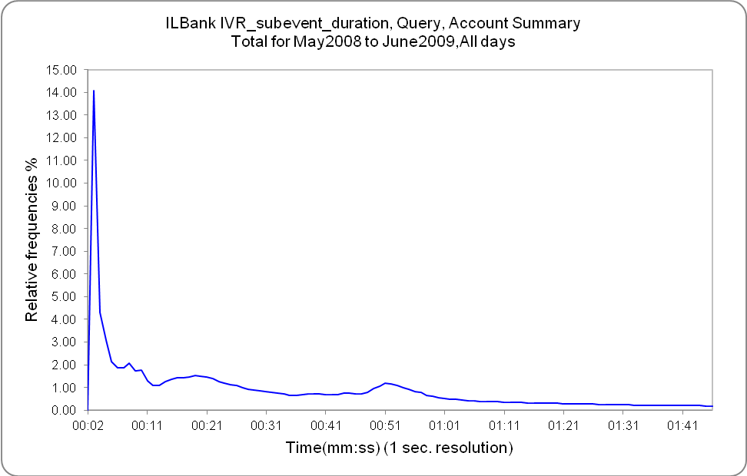
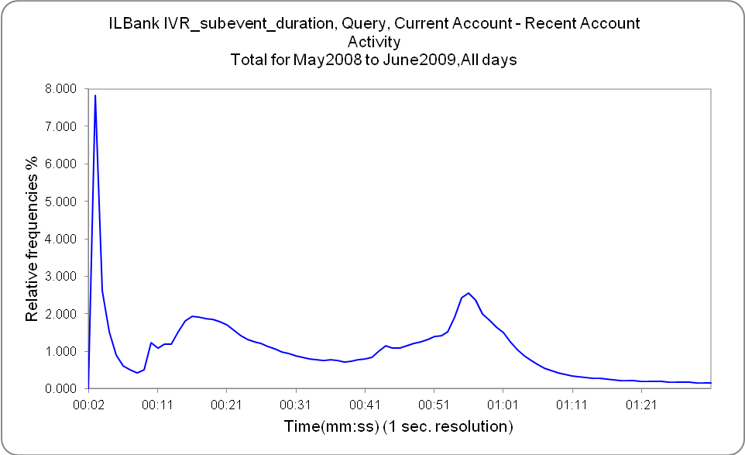
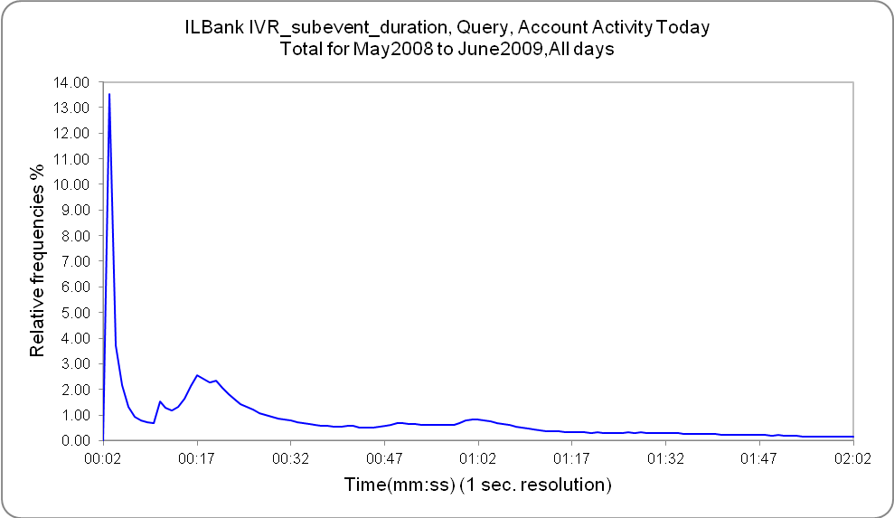
Introduction Literature Review Research Goals Search Model MDP Case Study Model Implications Summary
Case Study
Estimating services success probability
29

Slide 57
Introduction Literature Review Research Goals Search Model MDP Case Study Model Implications Summary
Case Study
Estimating services success probability
Threshold time
Threshold time
Threshold time
29

Slide 58
Introduction Literature Review Research Goals Search Model MDP Case Study Model Implications Summary
Case Study
Estimating services success probability
Parameter Estimates
Components | Mixing Proportions (%) | Location | Scale | Shape | Mean | Standard Deviation
1. Gamma | 4.86 |  | 0.39 | 10.13 | 3.99 | 1.252208
2. Gamma | 8.70 |  | 0.02 | 134.46 | 2.29 | 0.1977915
3. Gamma | 36.73 |  | 3.32 | 6.30 | 20.94 | 8.342206
4. Gamma | 27.91 |  | 2.44 | 21.60 | 52.77 | 11.35401
5. Gamma | 11.98 |  | 0.21 | 273.52 | 57.50 | 3.476888
6. Gamma | 9.82 |  | 10.08 | 9.25 | 93.22 | 30.65831
30

Slide 59
Introduction Literature Review Research Goals Search Model MDP Case Study Model Implications Summary
Introduction Literature Review Theoretical Model Empirical Analysis Model Implications Summary and Discussion
System Description
Model Implications
Comparing different IVR designs
(both customer and organization perspective).
31

Slide 60
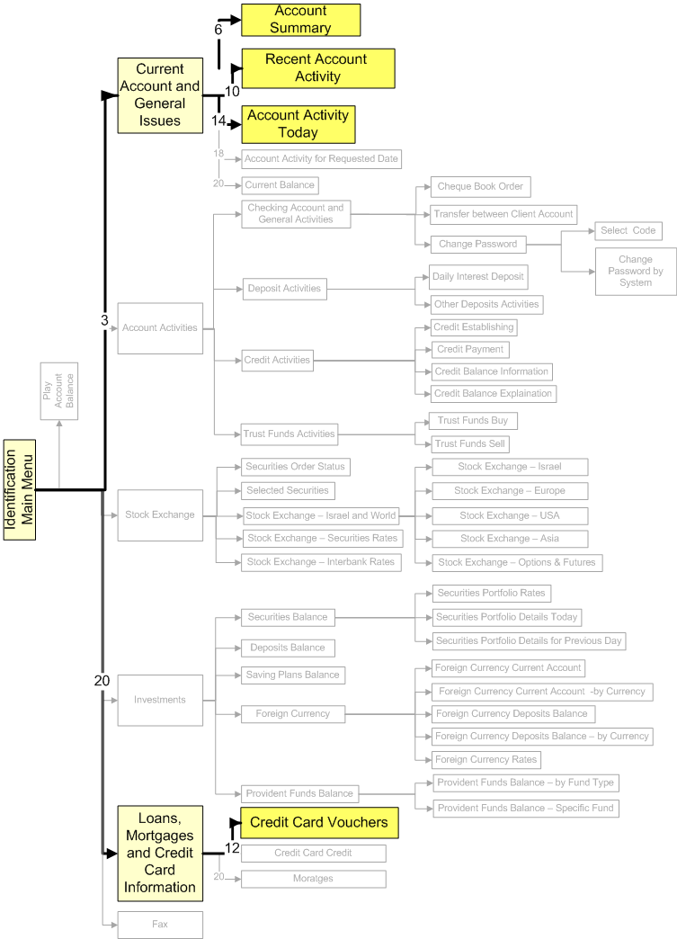
Introduction Literature Review Research Goals Search Model MDP Case Study Model Implications Summary
Introduction Literature Review Theoretical Model Empirical Analysis Model Implications Summary and Discussion
System Description
Model Implications
31

Slide 61
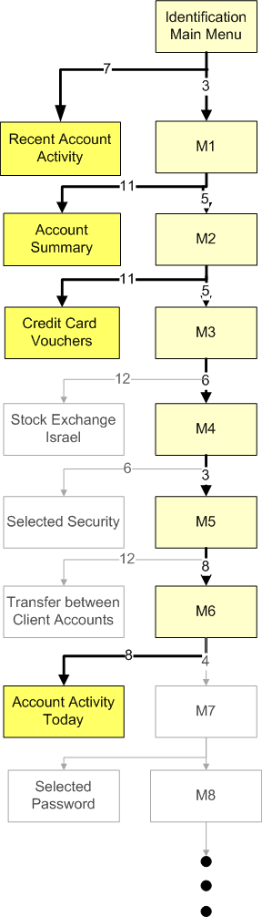
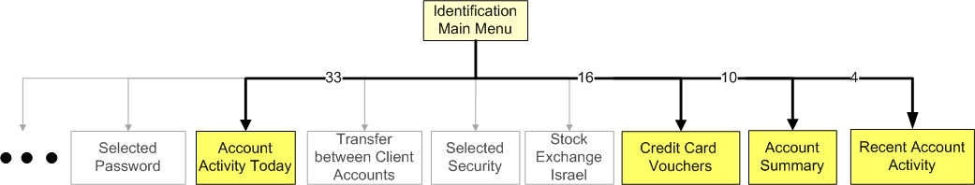
Introduction Literature Review Research Goals Search Model MDP Case Study Model Implications Summary
Introduction Literature Review Theoretical Model Empirical Analysis Model Implications Summary and Discussion
System Description
Model Implications
31

Slide 62
Introduction Literature Review Research Goals Search Model MDP Case Study Model Implications Summary
Introduction Literature Review Theoretical Model Empirical Analysis Model Implications Summary and Discussion
System Description
Model Implications
Comparing different IVR designs
(both customer and organization perspective).
Adding advertisements, encouraging the use of certain services?
Services with low demand – lack of interest or lack of patience?
Do customers navigate optimally? If not, why?
Imputed costs
Anticipating long waiting in agent queue – does it affect customer
behavior?
31

Slide 63
Introduction Literature Review Research Goals Search Model MDP Case Study Model Implications Summary
Introduction Literature Review Theoretical Model Empirical Analysis Model Implications Summary and Discussion
System Description
Summary and Future Research
Stochastic models of customer flow within the IVR
  Comparing IVR designs
  Insights for better designs
  Supplementing previous knowledge in HFE, CS fields
  Data analysis as a basis for theoretical models
  Can be easily modified to other self-service systems
Interesting open questions:
  How does one recognize an abandonment from self-service when “seeing” one?
  Interrelation between customer-IVR interaction and customer-agent interaction?
  How to use IVR and state information to control customers behavior?
Example: Web search engines
Hassan A. et al. (2010)
32

Slide 64
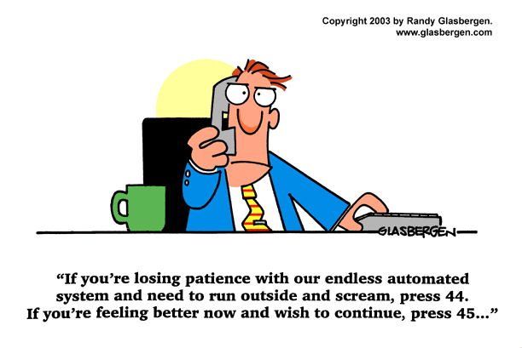
Thank you,
Questions?

Slide 65
Introduction Literature Review Research Goals Search Model MDP Case Study Model Implications Summary
Search Model
Model assumptions
i
l_{i}
j
k

Slide 66
Introduction Literature Review Research Goals Search Model MDP Case Study Model Implications Summary
MDP
Backward induction – Index calculation

Slide 67
Introduction Literature Review Research Goals Search Model MDP Case Study Model Implications Summary
Case Study
IVR services duration
17 seconds
56 seconds

Slide 68
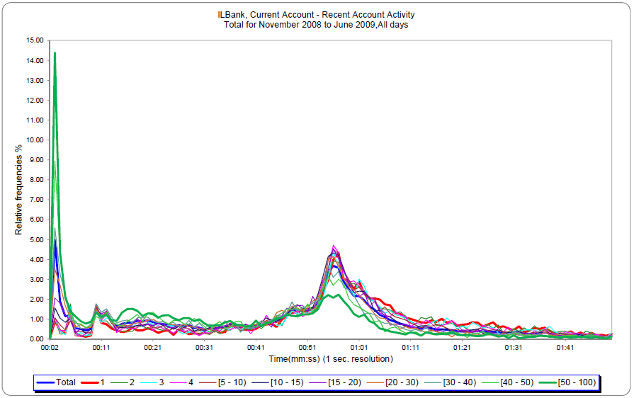

Slide 69
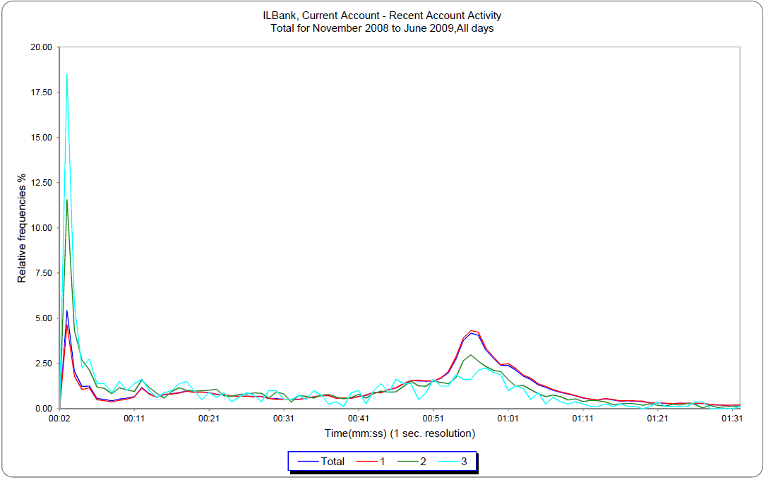
Across calls

Slide 70
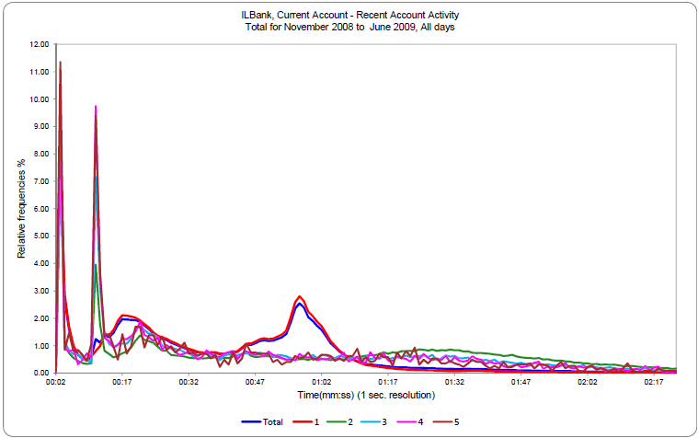
Within a call

