Slide 1
PhD Defense
Queue Mining:
Service Perspectives in Process Mining
Arik Senderovich
13/2/2017

Slide 2


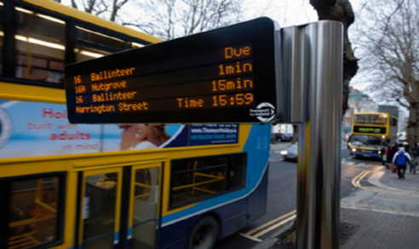

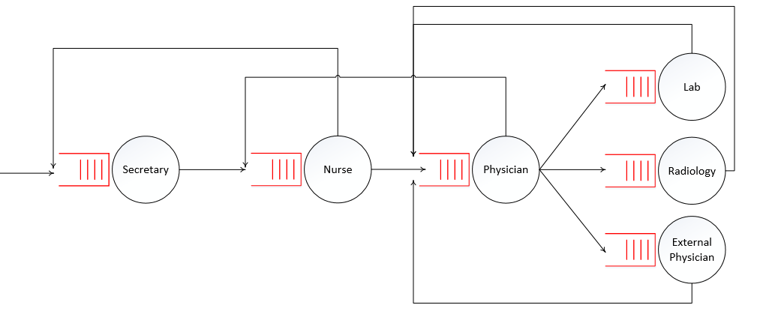
Service Processes
Processes where (efficient and effective) service is the desired business outcome:
Call centers
Hospitals
Transportation

Slide 3

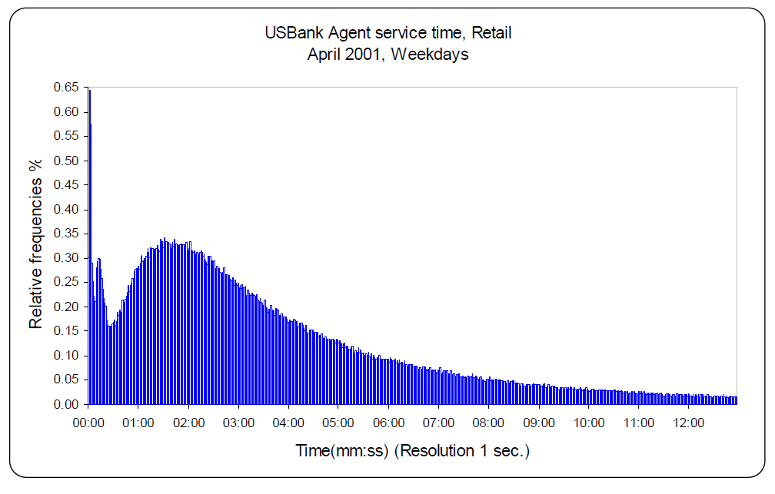
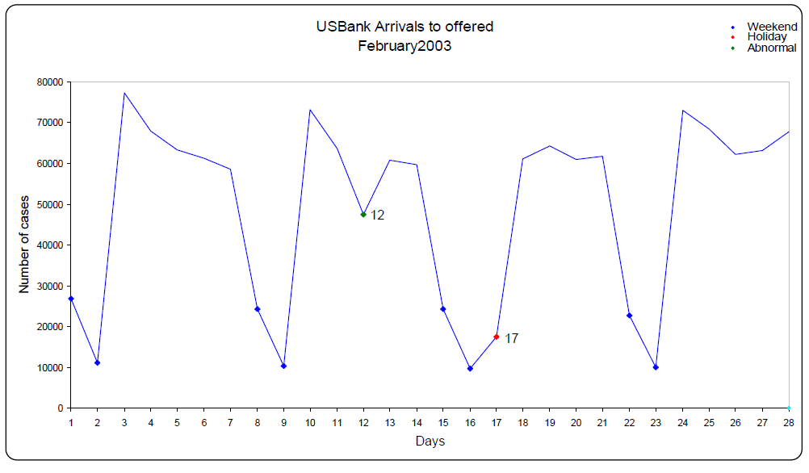
SEELab and SEEData

Slide 4
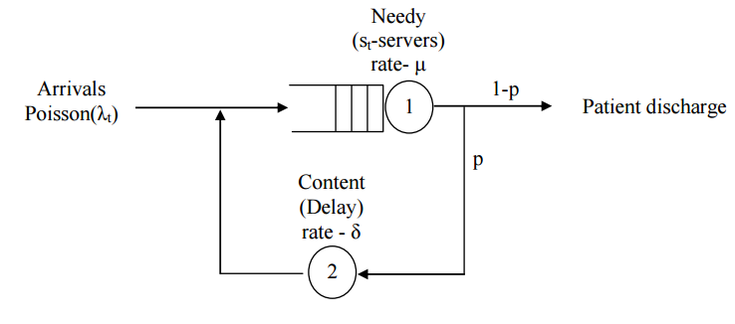
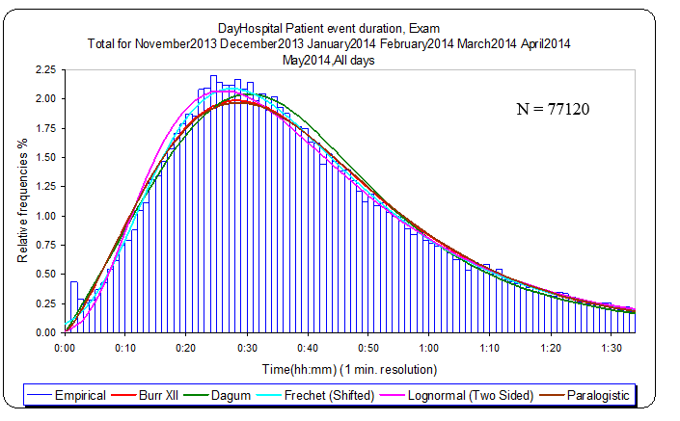
Hand-made Performance Modeling
Yom-Tov and Mandelbaum [2014]

Slide 5
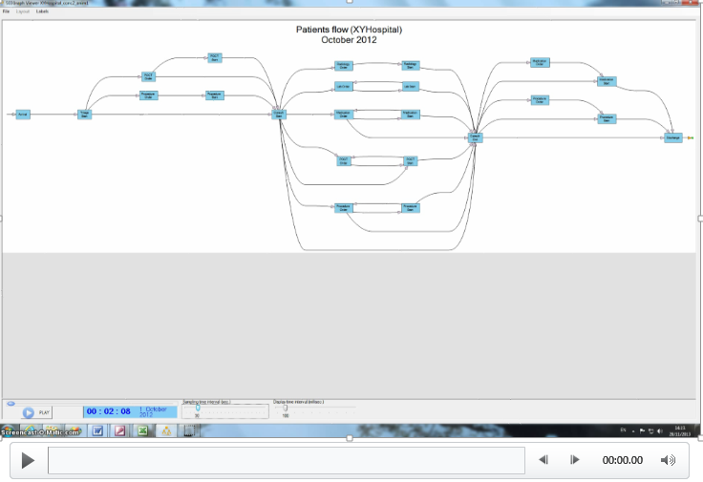
SEEGraph: Data-driven Modeling

Slide 6
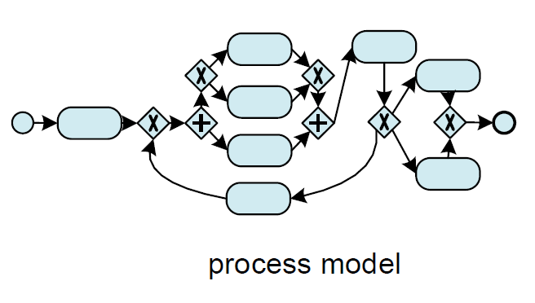



Automated process modeling based on data = Process mining
Logging
Notes:
Process mining is the industrial engineering of the 21st century!

Slide 7
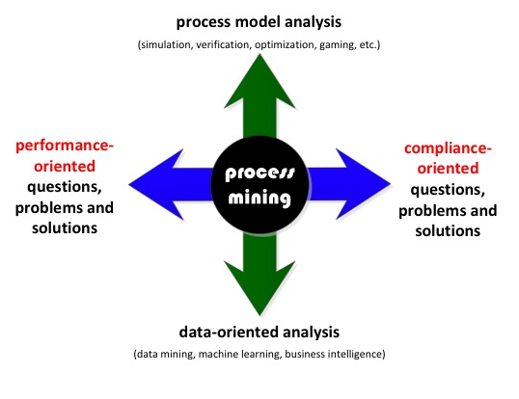
Process Mining: Drivers and Types
Illustration by Wil van der Aalst

Slide 8
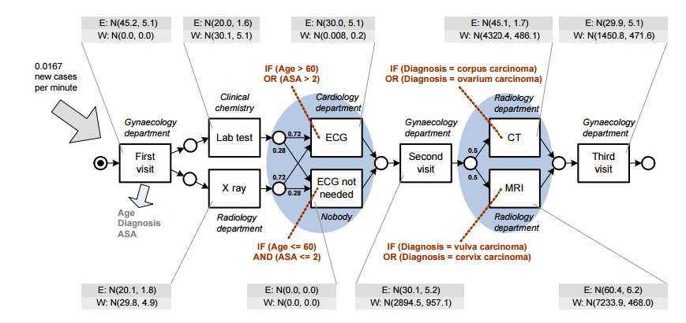
Approach I – Model-Based
From Rozinat et al. [2009]; Rogge-Solti et al. [2013]

Slide 9
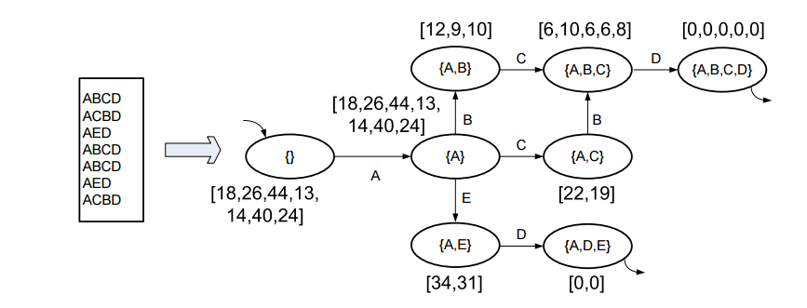
Approach II – Supervised Learning
From van der Aalst et al. [2011]

Slide 10

Please Mind the Gap
Interactions between cases that share (scarce) resources must be considered when modeling and predicting system’s performance
Especially in service processes where queueing for resources prevails

Slide 11
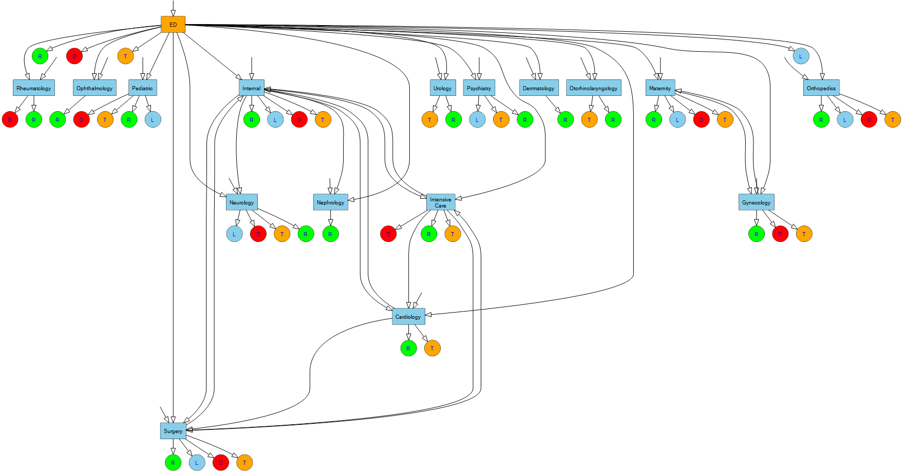
Queue mining =
Queueing perspective in process mining
S. A., Weidlich M., Gal A., Mandelbaum A., in Information Systems 2014
Logging
Notes:
Process mining is the industrial engineering of the 21st century!

Slide 12
Approach I – Model-Based
From Rozinat et al. [2009]; Rogge-Solti et al. [2013]

Slide 13
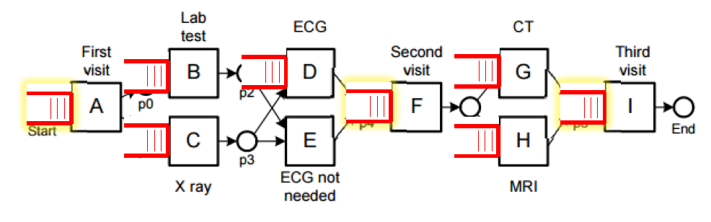
Model-Based Queue Mining
Queueing models:
Analytically simple models (efficiency) – no need for simulation
(Often) accurate performance analysis w.r.t. data (robust/generalize well)

Slide 14
Approach II – Supervised Learning
From van der Aalst et al. [2011]

Slide 15
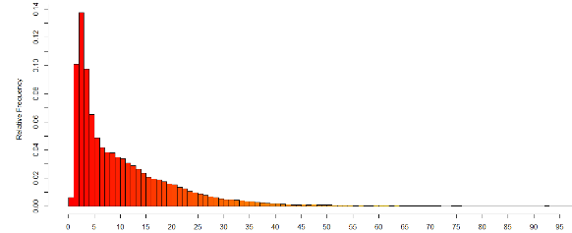
Supervised Queue Mining
Queueing features are added:
Examples: queue-lengths, delays, classes
Feature enrichment (here) and model adaptation (later)

Slide 16
Outline
Introduction
Single-station queues
Single-class
Multi-class
Queueing networks
Pre-defined routing
Random routing
Conformance checking with queueing networks
Work-in-progress

Slide 17
Single-Station Single-Class Queues
n
Are these useful models?

Slide 18
Single-Station Queues
n
Are these useful models?
Building block of networks

Slide 19
Single-Station Queues
Are these useful models?
Building block of networks
Single-resource type processes
Total time is delay (queueing) and process time

Slide 20
Queueing Model: Building Blocks
n
Abandonments
Kendall’s notation – A/B/C/Y/Z+X:
A – arrivals, B – service times
C – static server capacity (n servers); Y – queue size
Z – service policy (FCFS, LCFS, Processor Sharing…)
X – (Im)patience

Slide 21
Example: M/M/n
n
Assumptions (A/B/C/Y/Z+X):
Dropped notation Y,Z,X (defaults are taken): infinite queue size, FCFS policy, no abandonments
M - Poisson arrivals (completely random, one at a time, constant rate)
M - Exponentially distributed service times
Easy to analyze when parameters are known (data)

Slide 22
Problem: Delay Prediction
n
Abandonments
CAiSE2014 paper
with Weidlich, Gal, Mandelbaum
How long will the target customer wait?
Online prediction problem
Approach I – fit q-model (&parameters) from the log
Approach II – transition system + learning

Slide 23
Notation and Accuracy Measure
The actual waiting time of a customer:
Delay predictor from a certain method:
Accuracy via the root of average squared-error (RASE):
Systemic errors in assumptions- avg. absolute bias:

Slide 24
Approach I: Queueing Model is Fitted
n
Abandonments
G/M/n+M model:
Exponential service times and (im)patience
General arrival rates, FCFS policy, unlimited queue

Slide 25
Approach I: Analysis
n
Abandonments
Two families of delay predictors:
Queue-length (state based)
Snapshot principle (history based)

Slide 26
Queue-Length Predictors
Service
1
Queue
n
Abandonments
from Whitt [1999]

Slide 27
Queue-Length Method
L – number of customers ahead
Rate
Target customer in service
QL+s
QL+s-1
s
s-1
Rate; duration is 1/Rate

Slide 28
Snapshot Prediction: Last-to-Enter-Service (Armony et al., 2009; Ibrahim and Whitt, 2009)
Prediction:
The last customer to enter service waited w in queue

Slide 29
Approach II: Transition System Based
Transition system with queueing features:
Queue lengths are clustered (heavy, moderate, typical)
Prediction is based on QL cluster + progress

Slide 30
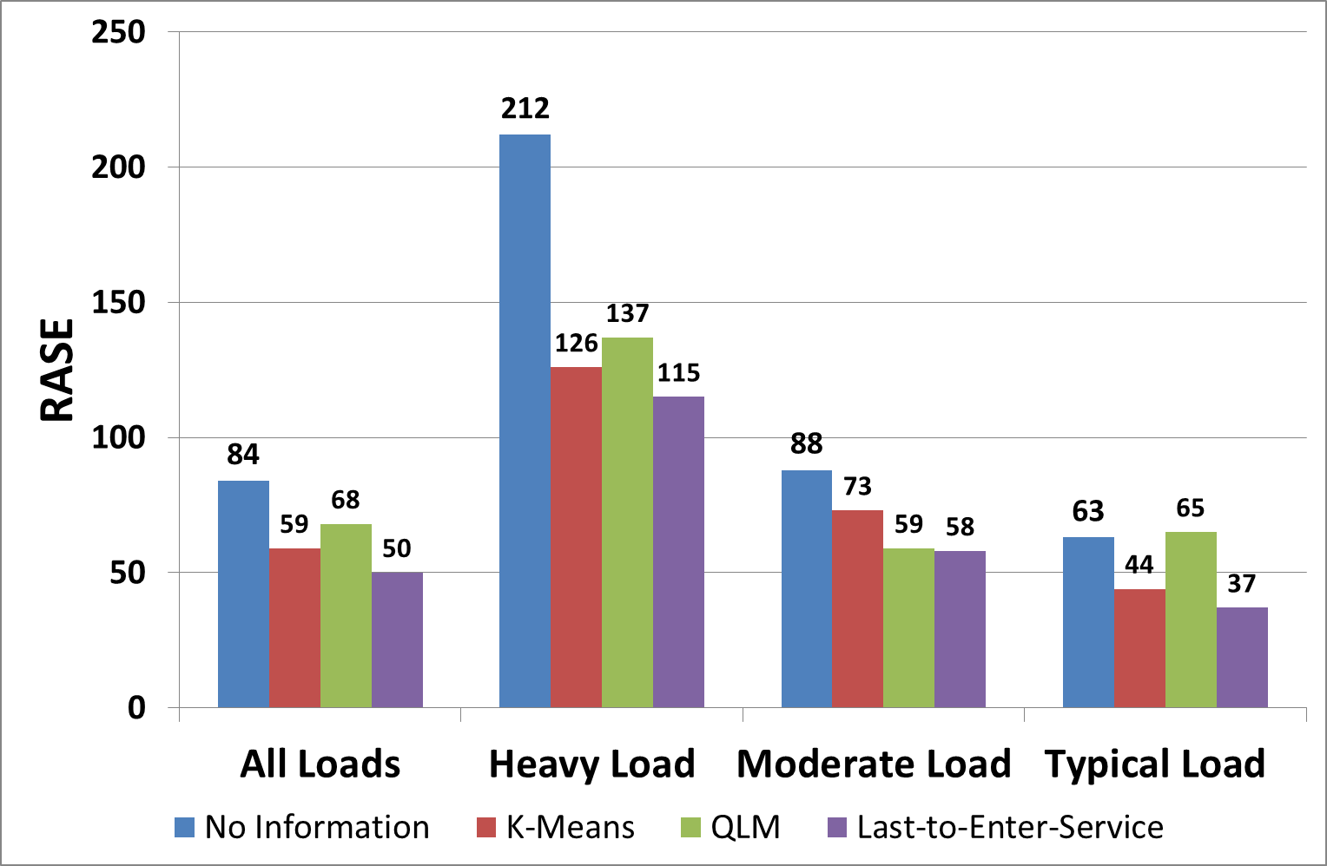
Results I: Bank’s Call Center Data

Slide 31
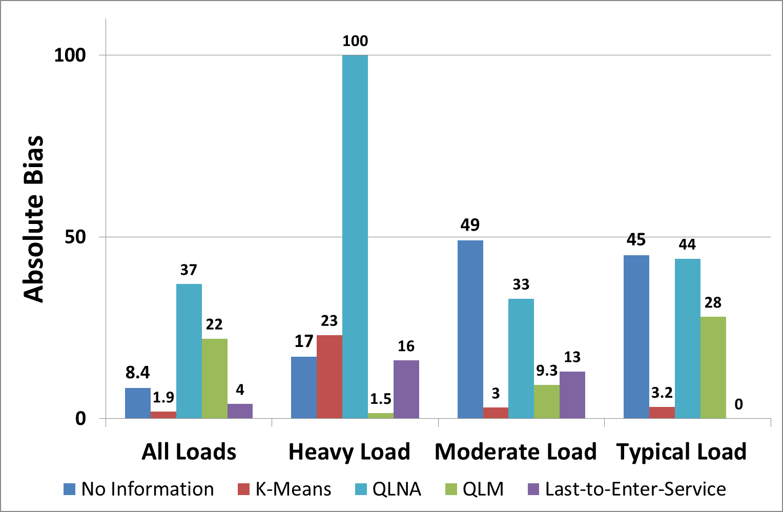
Results II: Bank’s Call Center Data

Slide 32
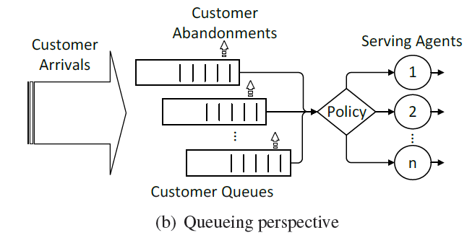
Single-Station Multi-Class Queues
Useful?

Slide 33
Single-Station Multi-Class Queues
Useful?
Different types of customers (VIP vs. Regular; Urgent vs. Ambulatory)

Slide 34
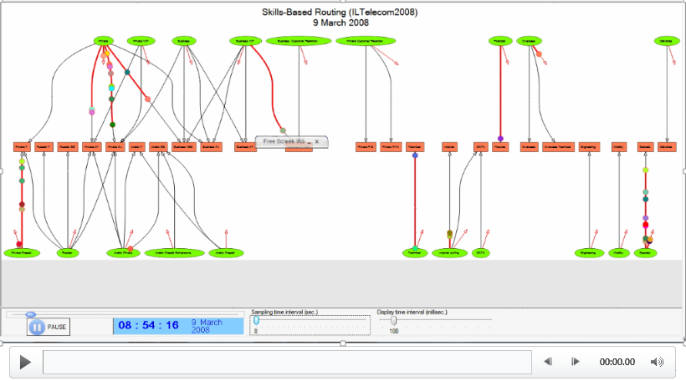
Multi-class Routing in SEEData

Slide 35
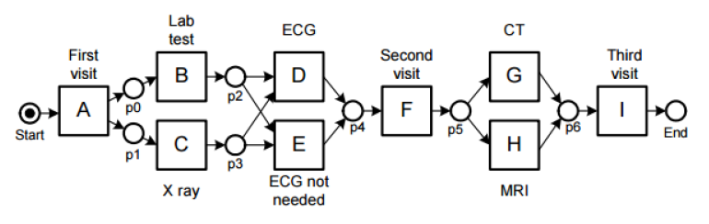
Single-Station Multi-Class Queues
Useful?
Different types of customers (VIP vs. Regular; Urgent vs. Ambulatory)
Classes = activities (A vs. F – A gets priority)

Slide 36
Single-Station Multi-Class Queues
Activity A
N
Activity F
Useful?
Different classes/types of customers (VIP vs. Regular; Urgent vs. Ambulatory)
Classes = activities (A vs. F – A gets priority)

Slide 37
Approach I for Multi-Class Queues
Information Systems [2014]
with Weidlich, Gal, Mandelbaum
Assuming priority queues model:
Queue length predictors – derived upper and lower bounds
Snapshot principle (based on Reiman and Simon [1990])

Slide 38
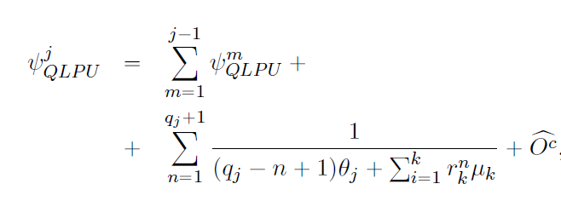
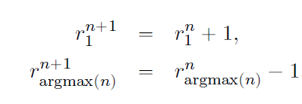
Multi-Class Queue-Length Prediction
Assumptions: non-preemptive, exponential service times (per class), Poisson arrivals (per class), FCFS within class
Upper and lower bounds:
Upper bound - “slowest” server completes service including “overtaking”
Lower bound – “fastest” server completes service, no “overtaking”

Slide 39
Approach II for Multi-Class Queues

Slide 40
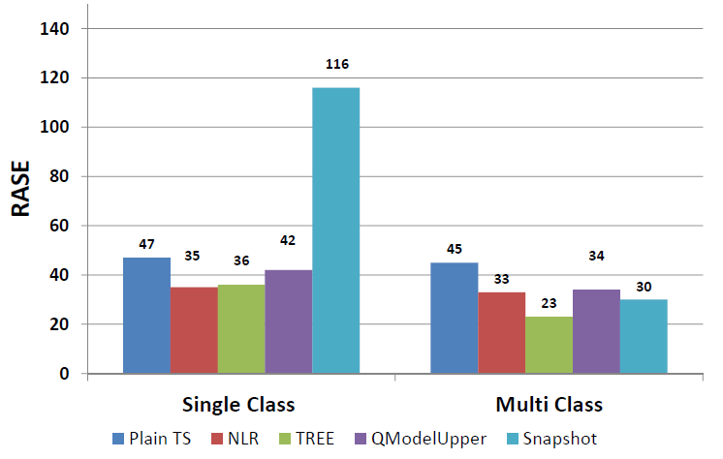
Results: Telecom Call Center Data
NLR, Tree – similar to De Leoni et al. [2014] (BPM14’ best paper)

Slide 41
What about networks of queues?
Snapshot principle holds in q-networks with pre-defined routing: public transport, outpatient clinics,…

Slide 42
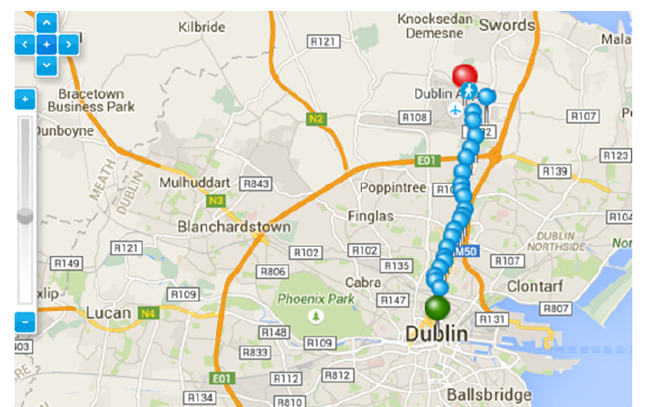
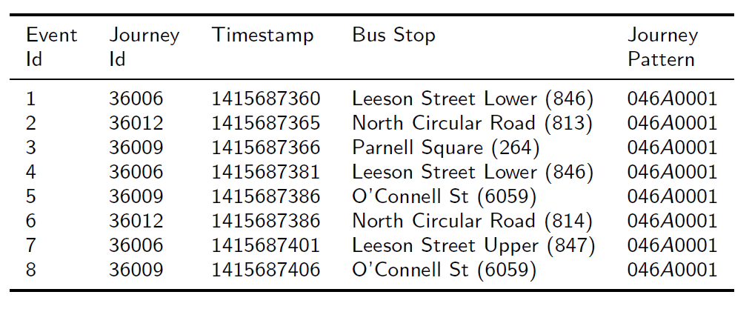
Bus Traveling Time Prediction
Information Systems [2015]
with Weidlich, Schnitzler,
Gal, Mandelbaum

Slide 43
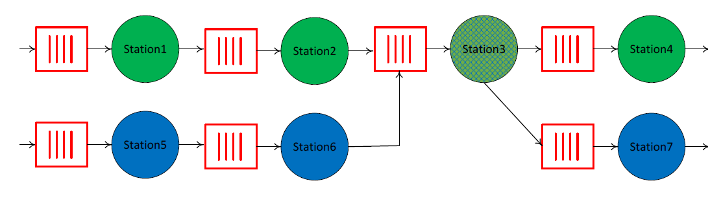
Bus Routes as Q-Networks

Slide 44
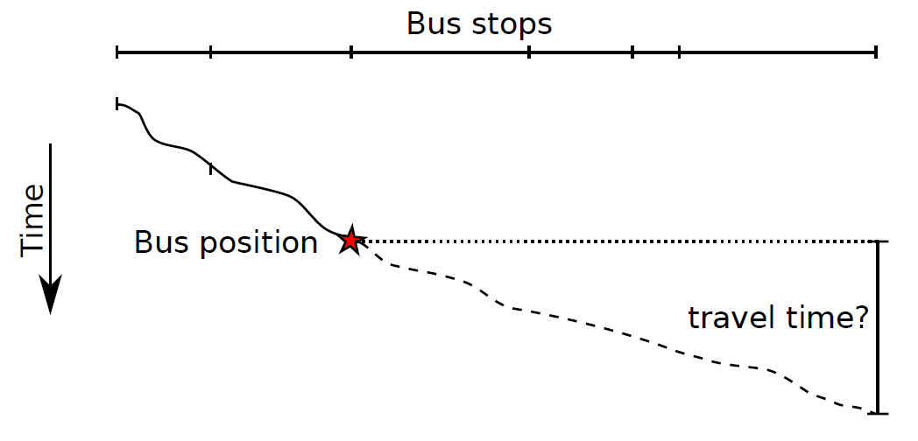
Prediction Problem

Slide 45
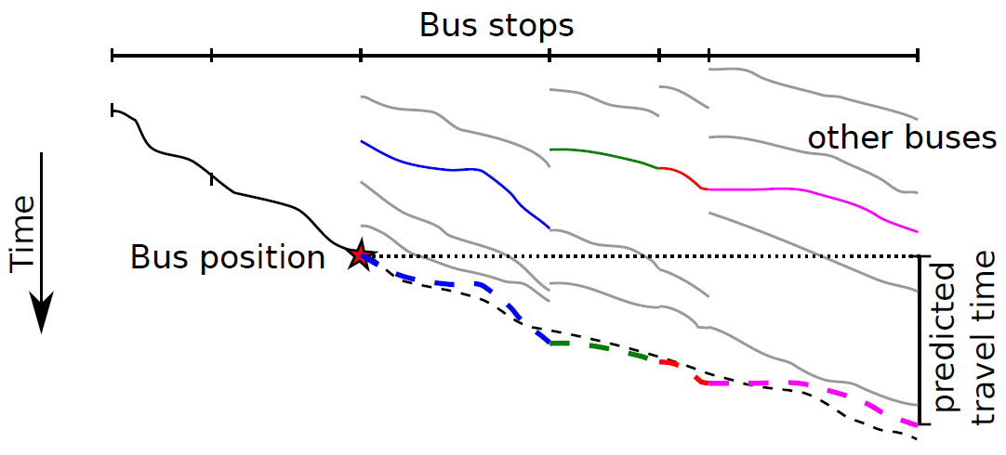
Snapshot Prediction

Slide 46
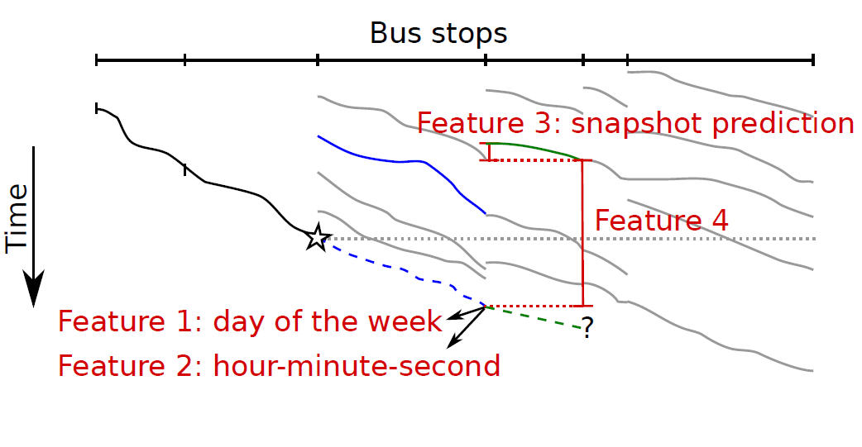
Feature Enrichment: Load-related + Snapshot Features

Slide 47
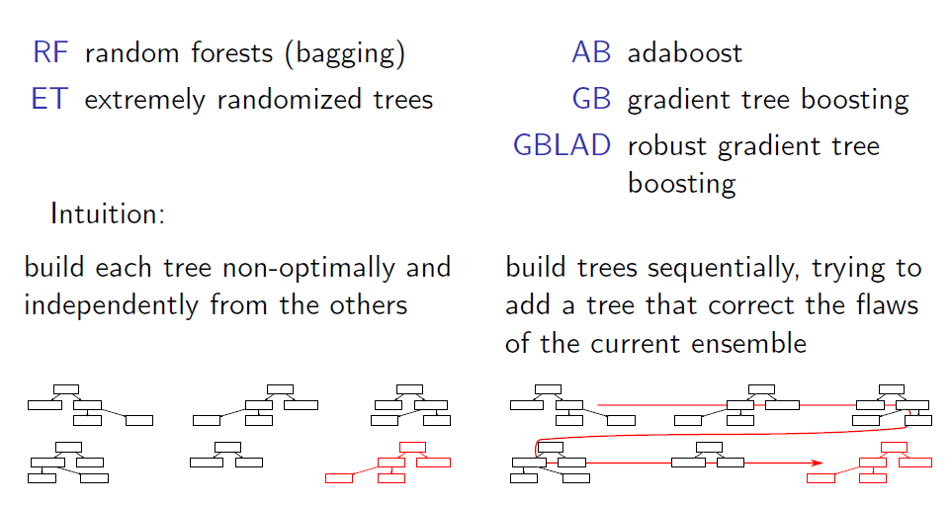
Ensemble of Regression Trees

Slide 48
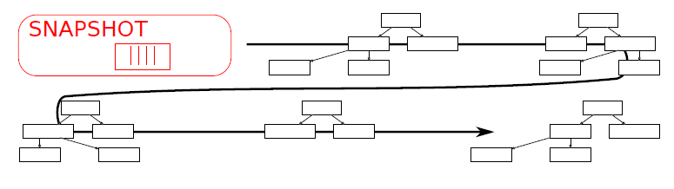
Learner adaptation: Boosting over the Snapshot Predictor

Slide 49
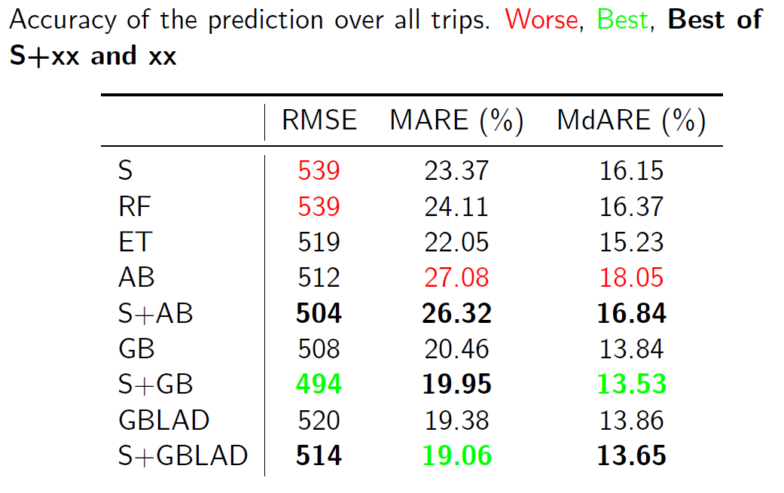
Results: Dublin Buses (GPS data)

Slide 50
What if routing is not pre-defined? (not in the PhD)
Approximation techniques, e.g. Queueing Network Analyzer (Whitt [1983]):
Allows concurrency and non-exponential times
Steady-state approx. (model per hour…)

Slide 51
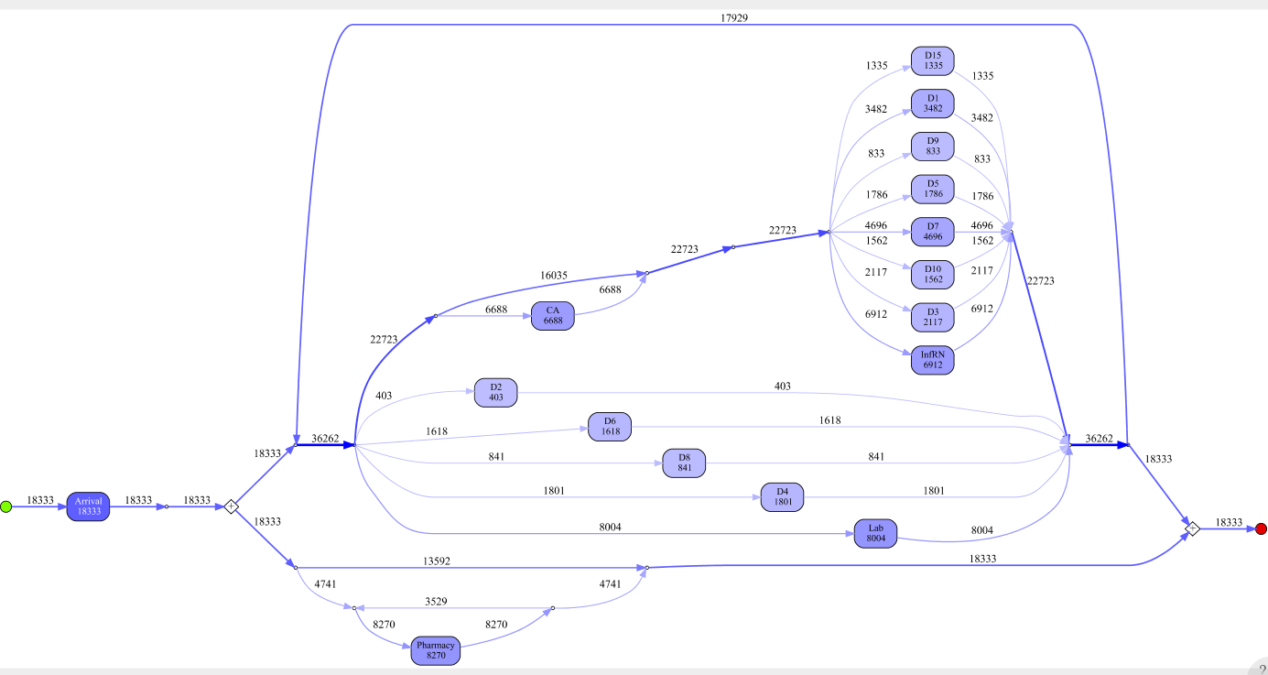
Idea: PN->GSPN->QN Transformation
Four step approach:
Control-flow discovery (e.g., IM)
Enrichment (firing times, arrivals, resources,…)
Simplification (helps to avoid over-fitting; feature selection)
Translation to QN for analysis (QNA)
BPM [2016], submitted to IS with Shleyfman, Weidlich, Gal, Mandelbaum

Slide 52
Outline
Introduction
Single-station queues
Single-class
Multi-class
Queueing networks
Pre-defined routing
Random routing
Conformance checking with queueing networks
Work-in-progress

Slide 53
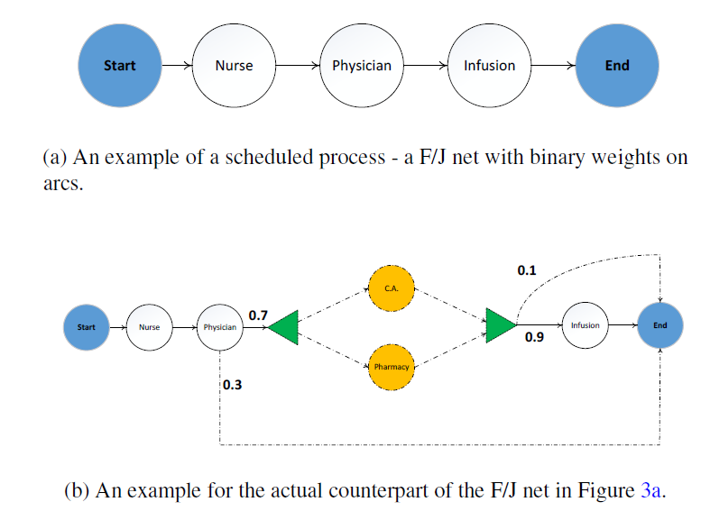
Conformance checking: A Queueing Network Perspective
Information systems [2015] with Yedidsion, Weidlich, Gal, Mandelbaum, Kadish, Bunnel

Slide 54
Conformance checking: A Queueing Network Perspective
The two queueing networks are compared:
Detect deviations between planned and actual performance measures
Root-cause analysis:
Compare structures (unscheduled activities)
Building blocks (arrivals, service times,…)
Root-cause of deviations can lead to performance improvement (example is coming up)

Slide 55
Statistical Comparison

Slide 56
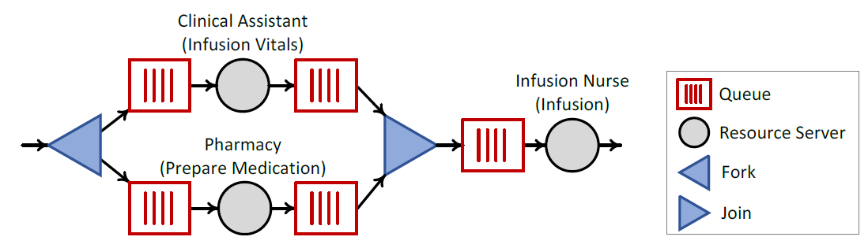
Example: Fork-Join Construct

Slide 57
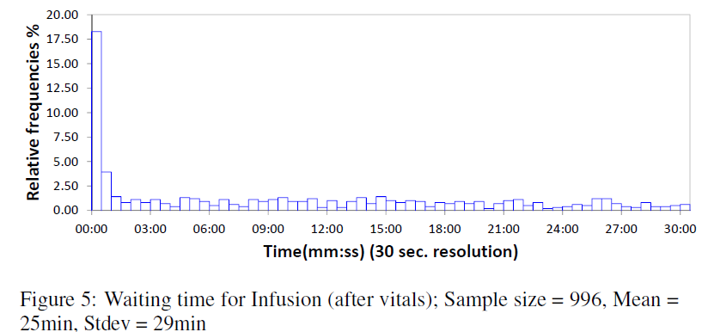
Step I: Unexpected Queueing
Drug is not ready!

Slide 58
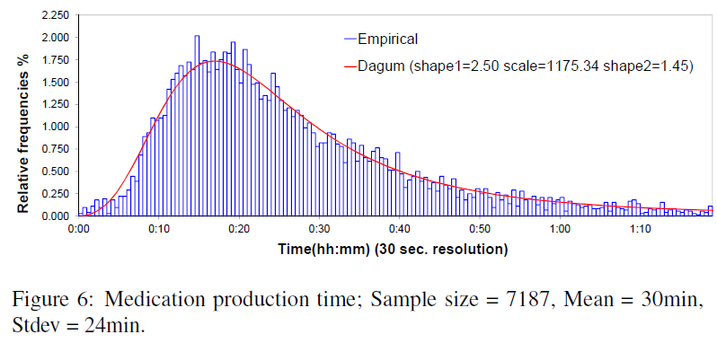
Step II: Production time is not the cause!

Slide 59
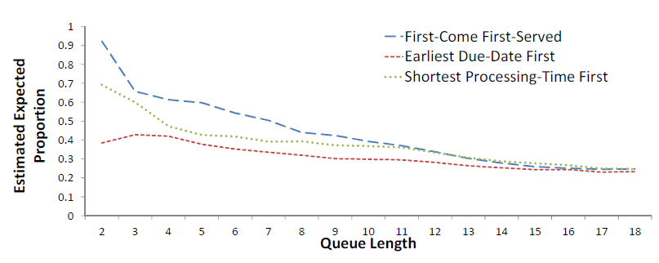
Step II: Production policy is…!

Slide 60
Process Improvement: Idea
New policy for sequencing “vitals” patients to reduce waiting and increase throughput
Dominates the EDD policy – proofs and experiments in the paper

Slide 61
Process Improvement Algorithms

Slide 62
Outline
Introduction
Single-station queues
Single-class
Multi-class
Queueing networks
Pre-defined routing
Random routing
Conformance checking with queueing networks
Work-in-progress

Slide 63
Work-in-Progress
Data-driven scheduling (with Gal, Karpas, Beck)
Feature learning in congested systems (with Weidlich, Gal)
Time series prediction with inter-case dependencies (with Di Francescomarino, Maria-Maggi)

Slide 64
Backup Slides

Slide 65
What if data is incomplete?
Discovering queues from event logs with varying information levels
(BPI [2015] with Leemans, Harel, Gal and van der Aalst [2015])

Slide 66
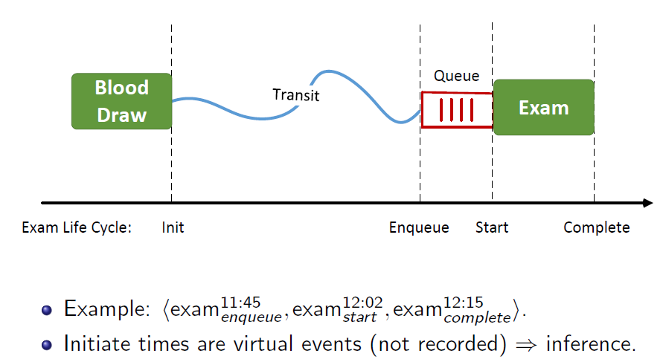
Queueing-Aware Activity Life-Cycle

Slide 67
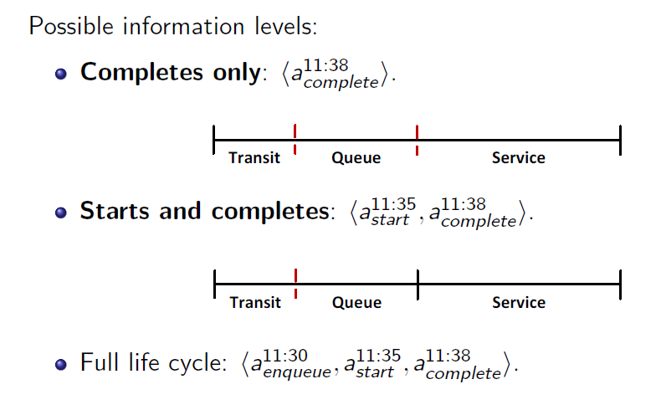
Levels of Information

Slide 68
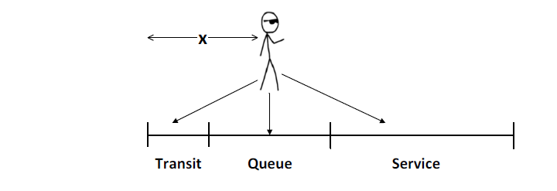
Maximum Likelihood(–like) Approach

Slide 69
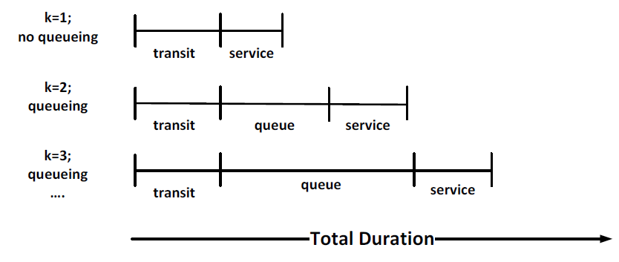
Intuition: Clustering of Durations

Slide 70
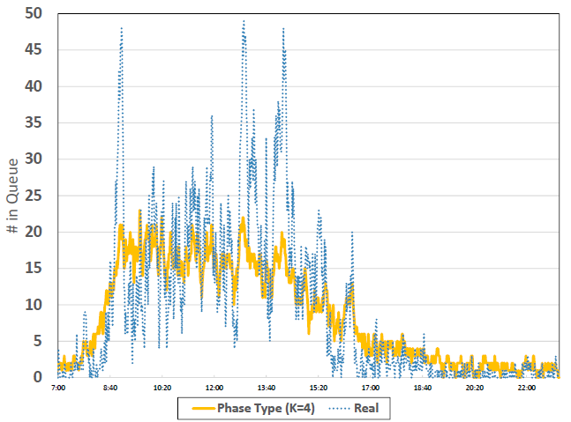
Results

