Slide 1

Modeling and Analyzing IVR Systems,
as a Special Case of Self-services
Nitzan Carmeli
MSc Advisors: Prof. Haya Kaspi, Prof. Avishai Mandelbaum
Empirical Support: Dr. Galit Yom-Tov
Industrial Engineering and Management
Technion
23.06.2014
1

Slide 2
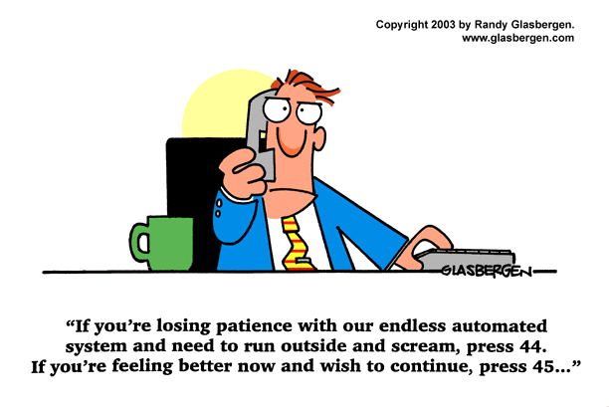
Introduction Literature Review Research Goals Search Model MDP Case Study Model Implications Summary
Introduction
Interactive Voice Response (Voice Response Unit)
2

Slide 3
Introduction Literature Review Research Goals Search Model MDP Case Study Model Implications Summary
Introduction
Agents salaries are typically 60%-80% of the overall operating
budget in call centers
3

Slide 4
Introduction Literature Review Research Goals Search Model MDP Case Study Model Implications Summary
Introduction
Agents salaries are typically 60%-80% of the overall operating
budget in call centers
Properly designed IVR system increase customer satisfaction
increase loyalty
decrease staffing costs
3

Slide 5
Introduction Literature Review Research Goals Search Model MDP Case Study Model Implications Summary
Introduction
Agents salaries are typically 60%-80% of the overall operating
budget in call centers
Properly designed IVR system increase customer satisfaction
increase loyalty
decrease staffing costs
Customers self-serve
Increase profit
3

Slide 6
Introduction Literature Review Research Goals Search Model MDP Case Study Model Implications Summary
Introduction
Call Center with an IVR system
IVR
?
Success
?
Abandonment
P
servers
Returns
4

Slide 7
Introduction Literature Review Research Goals Search Model MDP Case Study Model Implications Summary
Literature Review
Methodologies for evaluating IVRs
Quantifying IVR usability and cost-effectiveness
Agent time being saved by handling the call, or part of the call, in the IVR
Original reasons for calling vs. experience
(by analyzing end-to-end calls)
Suhm B. and Peterson P. (2002, 2009)
5

Slide 8
Introduction Literature Review Research Goals Search Model MDP Case Study Model Implications Summary
Literature Review
Methodologies for evaluating IVRs
Quantifying IVR usability and cost-effectiveness
Agent time being saved by handling the call, or part of the call, in the IVR
Original reasons for calling vs. experience
(by analyzing end-to-end calls)
Suhm B. and Peterson P. (2002, 2009)
30% completed service in IVR
Only 1.6% completed it successfully
5

Slide 9
Introduction Literature Review Research Goals Search Model MDP Case Study Model Implications Summary
Literature Review
Methodologies for evaluating IVRs
Quantifying IVR usability and cost-effectiveness
Agent time being saved by handling the call, or part of the call, in the IVR
Original reasons for calling vs. experience
(by analyzing end-to-end calls)
Suhm B. and Peterson P. (2002, 2009)
Designing and optimizing IVRs
Human-Factor-Engineering
Mainly comparing broad (shallow) designs and narrow (deep) designs.
Examples: Schumacher R. et al. (1995), Commarford P. et al. (2008) and many more.
30% completed service in IVR
Only 1.6% completed it successfully
5

Slide 10
Introduction Literature Review Research Goals Search Model MDP Case Study Model Implications Summary
Literature Review
Broad (shallow) design:
Narrow (deep) design:
0
0
6
5
4
3
2
1
1
2
3
4
6
5
6

Slide 11
Introduction Literature Review Research Goals Search Model MDP Case Study Model Implications Summary
Literature Review
Reducing IVR service times
The IVR menu as a service tree –
reducing the average time to reach a desired service
Salcedo-Sanz S. et al. (2010)
Stochastic search in a Forest
Models of stochastic search in the context of R&D projects
Optimality of index policy.
Denardo E.V., Rotblum U.G., Van der Heyden L. (2004)
Granot D. and Zuckerman D. (1991)
7

Slide 12
Introduction Literature Review Research Goals Search Model MDP Case Study Model Implications Summary
Research Goals
Modeling customer flow within an IVR system
Using EDA to estimate model parameters and identify usability
problems: has actually inspired our theoretical model
Using optimal search solutions and empirical analysis to compare
alternative designs and infer design implications
8

Slide 13
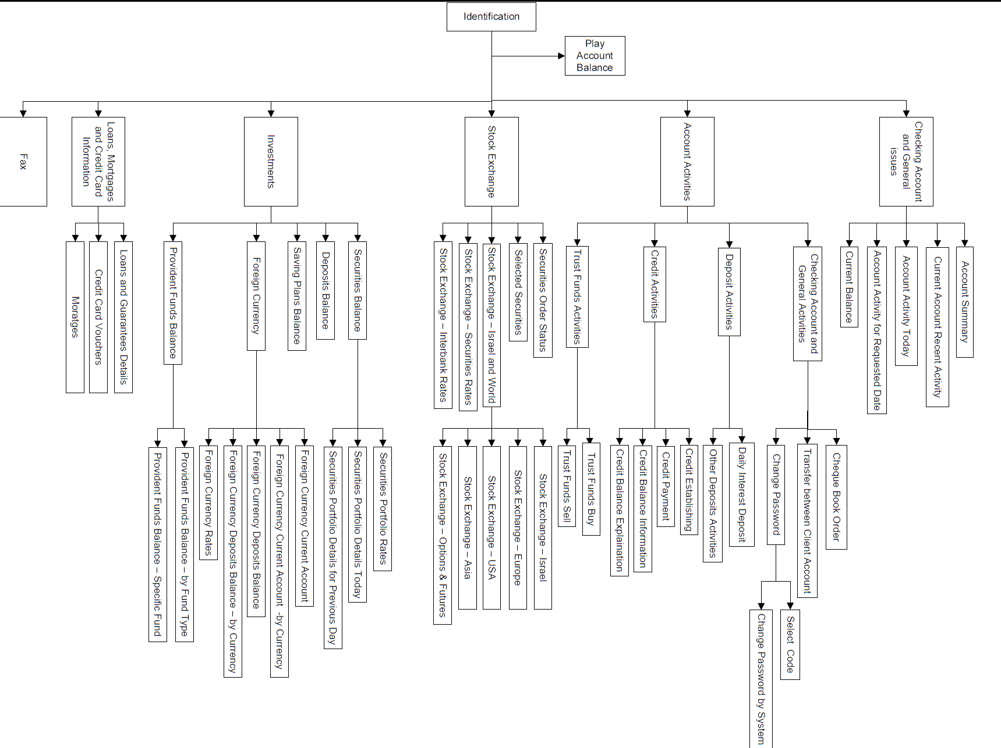
Introduction Literature Review Research Goals Search Model MDP Case Study Model Implications Summary
Search Model
Adapted from an actual IVR of a commercial enterprise
9

Slide 14
Introduction Literature Review Research Goals Search Model MDP Case Study Model Implications Summary
Search Model
Notations
s
b
a
e
d
c
g
f
10

Slide 15
Introduction Literature Review Research Goals Search Model MDP Case Study Model Implications Summary
Search Model
Notations
s
b
a
e
d
c
g
f
10

Slide 16
Introduction Literature Review Research Goals Search Model MDP Case Study Model Implications Summary
Search Model
Notations
s
b
a
e
d
c
g
f
10

Slide 17
Introduction Literature Review Research Goals Search Model MDP Case Study Model Implications Summary
Search Model
Notations
s
b
a
e
d
c
g
f
10

Slide 18
Introduction Literature Review Research Goals Search Model MDP Case Study Model Implications Summary
Search Model
Notations
s
b
a
e
d
c
g
f
10

Slide 19
Introduction Literature Review Research Goals Search Model MDP Case Study Model Implications Summary
Search Model
Notations
s
b
a
e
d
c
g
f
10

Slide 20
Introduction Literature Review Research Goals Search Model MDP Case Study Model Implications Summary
Search Model
Customer search
Customers pay for each unit of time they spend in the IVR
Customers receive reward when reaching a desired service
Customers may look for more than one service
Customers have finite patience
11

Slide 21
Introduction Literature Review Research Goals Search Model MDP Case Study Model Implications Summary
Search Model
Customer search
At each stage the customer can choose:
Terminate the search and leave the system
s
b
a
e
d
c
g
f
12

Slide 22
Introduction Literature Review Research Goals Search Model MDP Case Study Model Implications Summary
Search Model
Customer search
At each stage the customer can choose:
Terminate the search and leave the system
Terminate the search and opt-out to an agent
s
opt-out
b
a
opt-out
e
d
c
opt-out
g
f
12

Slide 23
Introduction Literature Review Research Goals Search Model MDP Case Study Model Implications Summary
Search Model
Customer search
At each stage the customer can choose:
Terminate the search and leave the system
Terminate the search and opt-out to an agent
Move forward to one of i’s immediate successors,
s
opt-out
b
a
opt-out
e
d
c
opt-out
g
f
12

Slide 24
Introduction Literature Review Research Goals Search Model MDP Case Study Model Implications Summary
Search Model
Customer search
At each stage the customer can choose:
Terminate the search and leave the system
Terminate the search and opt-out to an agent
Move forward to one of i’s immediate successors,
Move backward to i’s immediate predecessor,
s
opt-out
b
a
opt-out
e
d
c
opt-out
g
f
12

Slide 25
Introduction Literature Review Research Goals Search Model MDP Case Study Model Implications Summary
Search Model
Customer search
At each stage the customer can choose:
Terminate the search and leave the system
Terminate the search and opt-out to an agent
Move forward to one of i’s immediate successors,
Move backward to i’s immediate predecessor,
Move backward to the root vertex,
s
opt-out
b
a
opt-out
e
d
c
opt-out
g
f
12

Slide 26
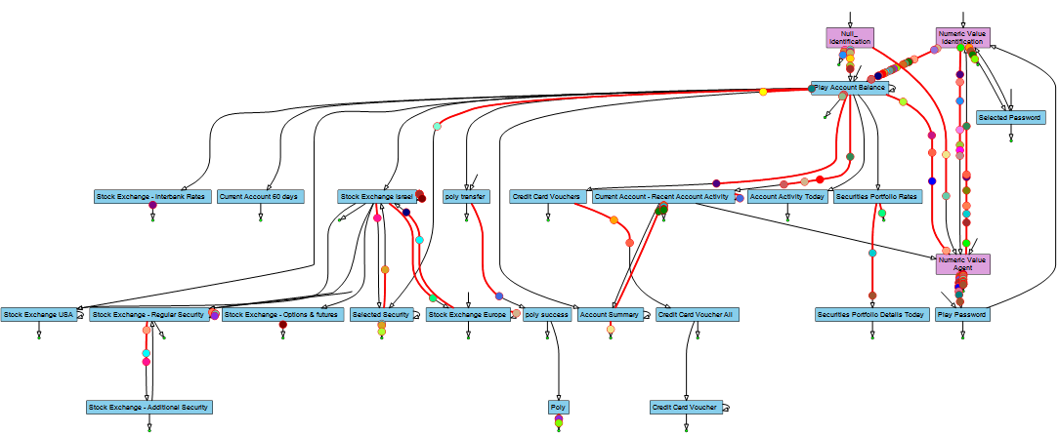
Introduction Literature Review Research Goals Search Model MDP Case Study Model Implications Summary
Search Model
IVR flow animation
13

Slide 27
Introduction Literature Review Research Goals Search Model MDP Case Study Model Implications Summary
Search Model
States
14

Slide 28


Introduction Literature Review Research Goals Search Model MDP Case Study Model Implications Summary
Search Model
Model Parameters - Edges
15

Slide 29
Introduction Literature Review Research Goals Search Model MDP Case Study Model Implications Summary
Search Model
16

Slide 30
Introduction Literature Review Research Goals Search Model MDP Case Study Model Implications Summary
Search Model
Model Parameters - Edges
17

Slide 31
Introduction Literature Review Research Goals Search Model MDP Case Study Model Implications Summary
Search Model
Model Parameters - Leaves
18

Slide 32
Introduction Literature Review Research Goals Search Model MDP Case Study Model Implications Summary
Search Model
Model Parameters - Leaves
18

Slide 33
Introduction Literature Review Research Goals Search Model MDP Case Study Model Implications Summary
Search Model
Search candidates
s
b
a
e
d
c
g
f
19

Slide 34
Introduction Literature Review Research Goals Search Model MDP Case Study Model Implications Summary
Search Model
Search candidates
s
b
a
e
d
c
g
f
19

Slide 35
Introduction Literature Review Research Goals Search Model MDP Case Study Model Implications Summary
Search Model
Search candidates
s
b
a
e
d
c
g
f
19

Slide 36
Introduction Literature Review Research Goals Search Model MDP Case Study Model Implications Summary
Search Model
Search candidates
s
b
a
e
d
c
g
f
19

Slide 37
Introduction Literature Review Research Goals Search Model MDP Case Study Model Implications Summary
Search Model
Search candidates
s
b
a
e
d
c
g
f
19

Slide 38
Introduction Literature Review Research Goals Search Model MDP Case Study Model Implications Summary
Search Model
Search candidates
s
b
a
e
d
c
g
f
19

Slide 39
Introduction Literature Review Research Goals Search Model MDP Case Study Model Implications Summary
Search Model
Search candidates
s
b
a
e
d
c
g
f
19

Slide 40
Introduction Literature Review Research Goals Search Model MDP Case Study Model Implications Summary
Search Model
Search candidates
s
b
a
e
d
c
g
f
19

Slide 41
Introduction Literature Review Research Goals Search Model MDP Case Study Model Implications Summary
Search Model
Search candidates
20

Slide 42
Introduction Literature Review Research Goals Search Model MDP Case Study Model Implications Summary
Search Model
Search candidates
21

Slide 43
Introduction Literature Review Research Goals Search Model MDP Case Study Model Implications Summary
Search Model
Search candidates
21

Slide 44
Introduction Literature Review Research Goals Search Model MDP Case Study Model Implications Summary
Search Model
Search candidates
22

Slide 45
Introduction Literature Review Research Goals Search Model MDP Case Study Model Implications Summary
Search Model
Search candidates
23

Slide 46








Introduction Literature Review Research Goals Search Model MDP Case Study Model Implications Summary
Search Model
Maximal Tree Algorithm
24

Slide 47









Introduction Literature Review Research Goals Search Model MDP Case Study Model Implications Summary
Search Model
Maximal Tree Algorithm
24

Slide 48


Introduction Literature Review Research Goals Search Model MDP Case Study Model Implications Summary
Search Model
Maximal Tree Algorithm
24

Slide 49













Introduction Literature Review Research Goals Search Model MDP Case Study Model Implications Summary
Search Model
Maximal Tree Algorithm
24

Slide 50








Introduction Literature Review Research Goals Search Model MDP Case Study Model Implications Summary
Search Model
Maximal Tree Algorithm
25

Slide 51
Introduction Literature Review Research Goals Search Model MDP Case Study Model Implications Summary
Search Model
26

Slide 52
Introduction Literature Review Research Goals Search Model MDP Case Study Model Implications Summary
MDP
Backward induction – Index calculation
z
27

Slide 53
Introduction Literature Review Research Goals Search Model MDP Case Study Model Implications Summary
MDP
Backward induction – Index calculation
28

Slide 54
Introduction Literature Review Research Goals Search Model MDP Case Study Model Implications Summary
MDP
Backward induction – Index calculation
29

Slide 55
Introduction Literature Review Research Goals Search Model MDP Case Study Model Implications Summary
MDP
Backward induction – Index calculation
30

Slide 56
Introduction Literature Review Research Goals Search Model MDP Case Study Model Implications Summary
MDP
Backward induction – Index calculation
30

Slide 57
Introduction Literature Review Research Goals Search Model MDP Case Study Model Implications Summary
MDP
Backward induction – Index calculation
31

Slide 58
Introduction Literature Review Research Goals Search Model MDP Case Study Model Implications Summary
MDP
32

Slide 59
Introduction Literature Review Research Goals Search Model MDP Case Study Model Implications Summary
MDP
32

Slide 60
Introduction Literature Review Research Goals Search Model MDP Case Study Model Implications Summary
MDP
32

Slide 61
Introduction Literature Review Research Goals Search Model MDP Case Study Model Implications Summary
Introduction Literature Review Theoretical Model Empirical Analysis Model Implications Summary and Discussion
System Description
Case Study
A medium bank
About 450 working agents per day (~200 during peak hours)
Call by call data from May 1st, 2008 to June 30th, 2009
Overall Summary of calls
IVR Calls | Total | % Out of total | Average per weekday
# Served only by IVR | 27,709,543 | 61.6% | 50,937
# Requesting also agent service | 17,280,159 | 38.4% | 31,765
33

Slide 62
Introduction Literature Review Research Goals Search Model MDP Case Study Model Implications Summary
Introduction Literature Review Theoretical Model Empirical Analysis Model Implications Summary and Discussion
System Description
Case Study
A medium bank
About 450 working agents per day (~200 during peak hours)
Call by call data from May 1st, 2008 to June 30th, 2009
Overall Summary of calls
IVR Calls | Total | % Out of total | Average per weekday
# Served only by IVR | 27,709,543 | 61.6% | 50,937
# Requesting also agent service | 17,280,159 | 38.4% | 31,765
10% of IVR calls – Identification only!
33

Slide 63
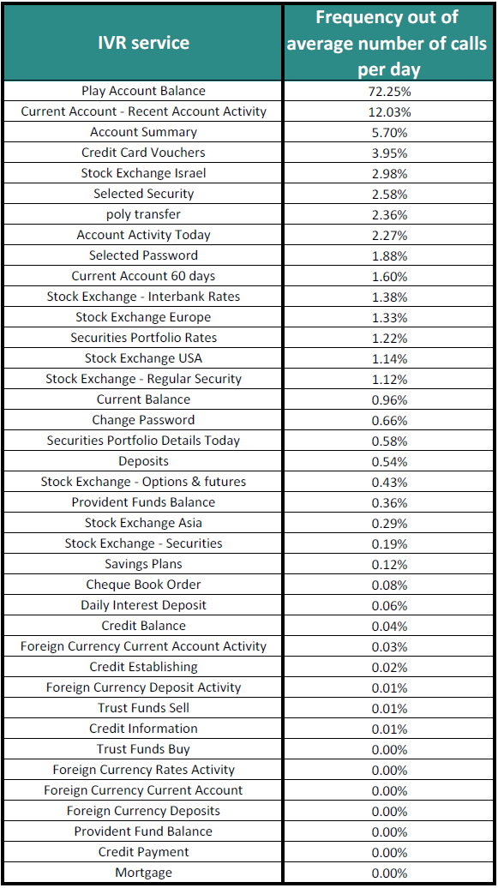
Introduction Literature Review Research Goals Search Model MDP Case Study Model Implications Summary
Case Study
34

Slide 64
Introduction Literature Review Research Goals Search Model MDP Case Study Model Implications Summary
Case Study
Requested by less than 2% of the calls
34

Slide 65
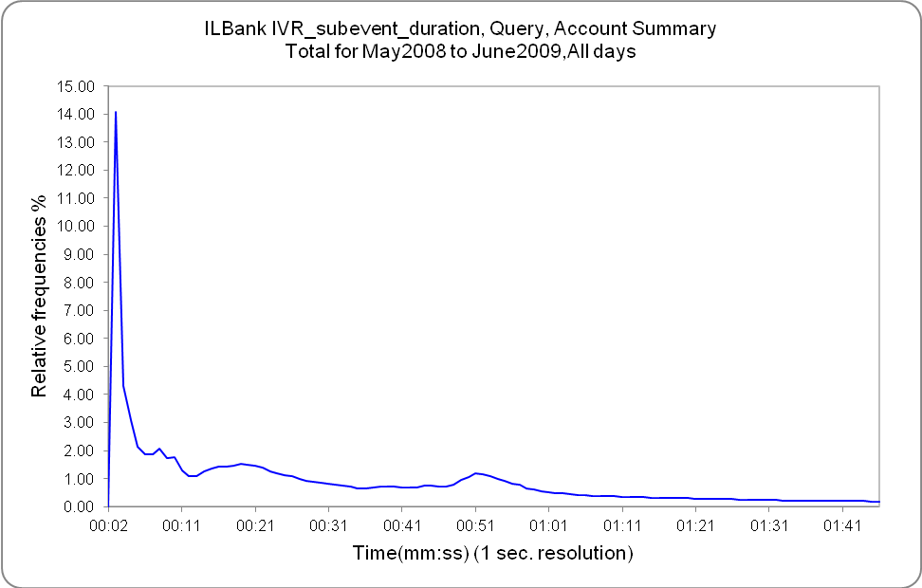
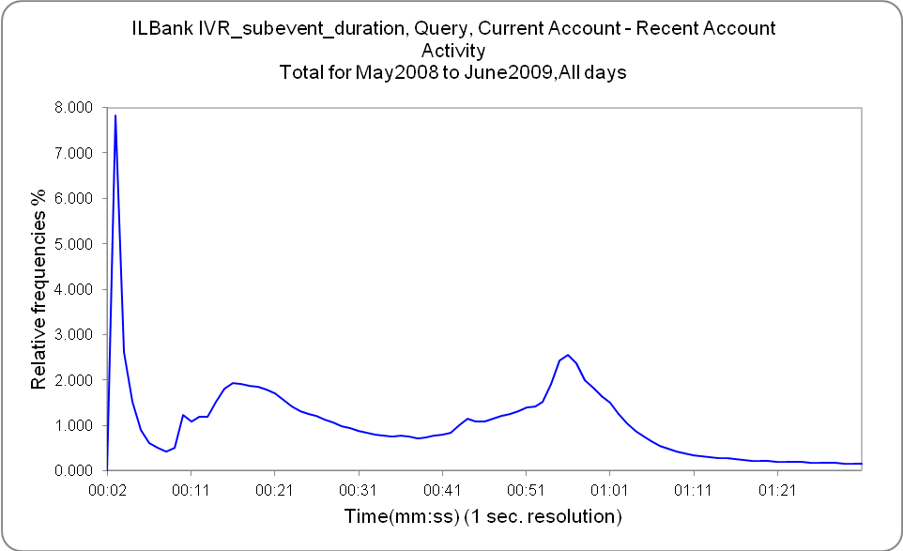
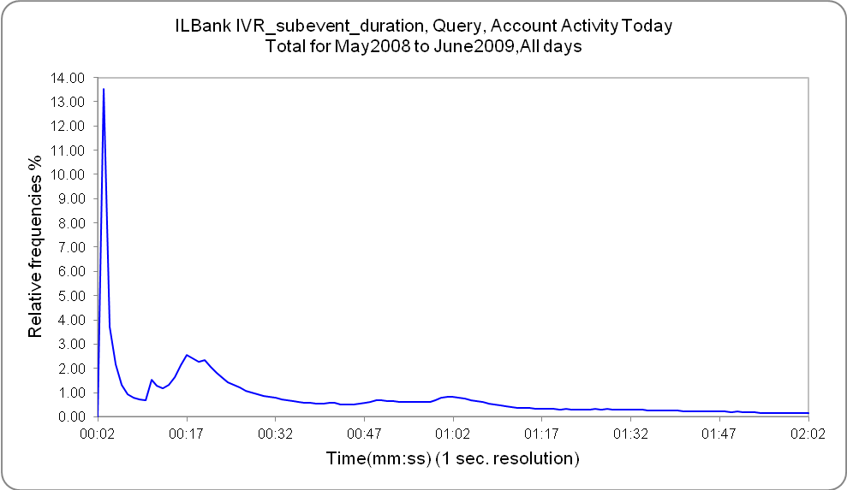
Introduction Literature Review Research Goals Search Model MDP Case Study Model Implications Summary
Case Study
Estimating abandonments
35

Slide 66
Introduction Literature Review Research Goals Search Model MDP Case Study Model Implications Summary
Case Study
Estimating abandonments
Threshold time
Threshold time
Threshold time
35

Slide 67
Introduction Literature Review Research Goals Search Model MDP Case Study Model Implications Summary
Case Study
Estimating abandonments
Parameter Estimates
Components | Mixing Proportions (%) | Scale | Shape | Mean | Standard Deviation
1. Lognormal | 5.19 | 1.34180 | 0.35 | 4.07 | 1.49
2. Lognormal | 8.20 | 0.83213 | 0.08 | 2.30 | 0.18
3. Lognormal | 39.05 | 3.05912 | 0.45 | 23.53 | 11.03
4. Lognormal | 26.03 | 3.95811 | 0.20 | 53.43 | 10.85
5. Lognormal | 11.80 | 4.04316 | 0.06 | 57.11 | 3.47
6. Lognormal | 9.73 | 4.51403 | 0.31 | 95.92 | 30.95
36

Slide 68
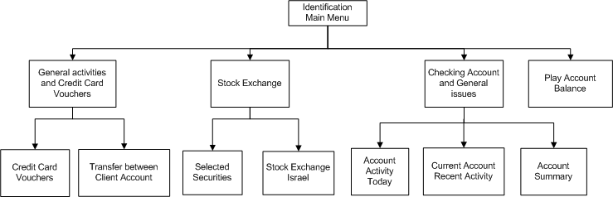
Introduction Literature Review Research Goals Search Model MDP Case Study Model Implications Summary
Introduction Literature Review Theoretical Model Empirical Analysis Model Implications Summary and Discussion
System Description
Model Implications
Example - Comparing different designs
(based on frequent services in our database)
37

Slide 69
Introduction Literature Review Research Goals Search Model MDP Case Study Model Implications Summary
Introduction Literature Review Theoretical Model Empirical Analysis Model Implications Summary and Discussion
System Description
Model Implications
Example - Comparing different designs
Service | r Type 1 | tser (mean, sec) | tF (mean, sec) | P
Play account balance | 200c | 21 | 6 | 0.75
Account Summary | 0 | 51 | 5 | 0.765
Recent Account Activity | 400c | 45 | 3 | 0.87
Account Activity Today | 0 | 50 | 3 | 0.78
Selected Securities | 0 | 43 | 3 | 0.7
Stock Exchange Israel | 0 | 16 | 7 | 0.775
Transfer between Account | 0 | 17 | 3 | 0.6
Credit Card Vouchers | 600c | 49 | 3 | 0.915
38

Slide 70
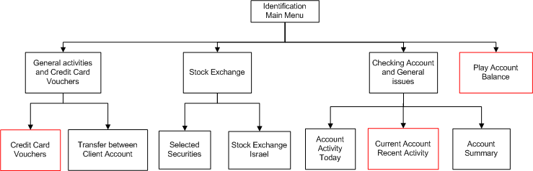
Introduction Literature Review Research Goals Search Model MDP Case Study Model Implications Summary
Introduction Literature Review Theoretical Model Empirical Analysis Model Implications Summary and Discussion
System Description
Model Implications
Example - Comparing different designs
Design A - original:
Optimal candidate :
Customer revenue:
39

Slide 71
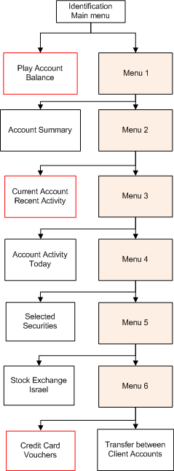
Introduction Literature Review Research Goals Search Model MDP Case Study Model Implications Summary
Introduction Literature Review Theoretical Model Empirical Analysis Model Implications Summary and Discussion
System Description
Model Implications
Example - Comparing different designs
Design B - deep:
Optimal candidate:
Customer revenue:
40

Slide 72
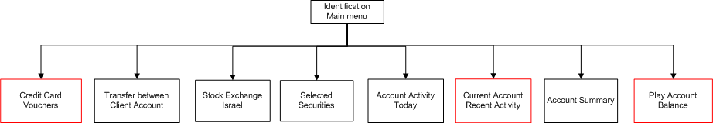
Introduction Literature Review Research Goals Search Model MDP Case Study Model Implications Summary
Introduction Literature Review Theoretical Model Empirical Analysis Model Implications Summary and Discussion
System Description
Model Implications
Example - Comparing different designs
Design C - shallow:
Optimal candidate:
Customer revenue:
41

Slide 73
Introduction Literature Review Research Goals Search Model MDP Case Study Model Implications Summary
Introduction Literature Review Theoretical Model Empirical Analysis Model Implications Summary and Discussion
System Description
Model Implications
Comparing different designs – Organization point of view
Example, assume:
10,000 calls per day
Cost per unit of time of communication = 0.003 NIS/sec
Cost per second of agent call = 0.03 NIS/sec (based on UG project)
 | Design A - Original | Design B – Deep | Design C - Shallow
Customer revenue | 3.38 | 2.74 | 3.61
Cost of communication | 4,736 | 5,606 | 4,826
Revenue from saved agent time | 30,564 | 30,564 | 30,564
Total organization profit | 25,828 | 24,958 | 25,738
42

Slide 74
Introduction Literature Review Research Goals Search Model MDP Case Study Model Implications Summary
Introduction Literature Review Theoretical Model Empirical Analysis Model Implications Summary and Discussion
System Description
Model Implications
How to design an IVR tree to encourage the use of certain services?
43

Slide 75
Introduction Literature Review Research Goals Search Model MDP Case Study Model Implications Summary
Introduction Literature Review Theoretical Model Empirical Analysis Model Implications Summary and Discussion
System Description
Model Implications
How to design an IVR tree to encourage the use of certain services?
Customer learning?
43

Slide 76
Introduction Literature Review Research Goals Search Model MDP Case Study Model Implications Summary
Introduction Literature Review Theoretical Model Empirical Analysis Model Implications Summary and Discussion
System Description
Model Implications
How to design an IVR tree to encourage the use of certain services?
Customer learning?
Do customers navigate optimally?
Services with low demand – lack of interest or lack of patience?
43

Slide 77
Introduction Literature Review Research Goals Search Model MDP Case Study Model Implications Summary
Introduction Literature Review Theoretical Model Empirical Analysis Model Implications Summary and Discussion
System Description
Model Implications
How to design an IVR tree to encourage the use of certain services?
Customer learning?
Do customers navigate optimally?
Services with low demand – lack of interest or lack of patience?
Sensitivity to customer patience?
Anticipating long waiting in agent queue – does it affect customer
behavior?
43

Slide 78
Introduction Literature Review Research Goals Search Model MDP Case Study Model Implications Summary
Introduction Literature Review Theoretical Model Empirical Analysis Model Implications Summary and Discussion
System Description
Model Implications
How to design an IVR tree to encourage the use of certain services?
Customer learning?
Do customers navigate optimally?
Services with low demand – lack of interest or lack of patience?
Sensitivity to customer patience?
Anticipating long waiting in agent queue – does it affect customer
behavior?
Using IVR and state information to control customers behavior
examples: return later, use IVR for service
43

Slide 79
Introduction Literature Review Research Goals Search Model MDP Case Study Model Implications Summary
Introduction Literature Review Theoretical Model Empirical Analysis Model Implications Summary and Discussion
System Description
Summary and Future research
Stochastic models of customer flow within the IVR
Comparing IVR designs
Insights for better designs
Supplementing previous knowledge in HFE, CS fields
Data analysis as a basis for theoretical models
Can be easily modified to other self-service systems
44

Slide 80
Introduction Literature Review Research Goals Search Model MDP Case Study Model Implications Summary
Introduction Literature Review Theoretical Model Empirical Analysis Model Implications Summary and Discussion
System Description
Summary and Future research
Stochastic models of customer flow within the IVR
Comparing IVR designs
Insights for better designs
Supplementing previous knowledge in HFE, CS fields
Data analysis as a basis for theoretical models
Can be easily modified to other self-service systems
Example: Web search engines
Hassan A. et al. (2010)
44

Slide 81
Introduction Literature Review Research Goals Search Model MDP Case Study Model Implications Summary
Introduction Literature Review Theoretical Model Empirical Analysis Model Implications Summary and Discussion
System Description
Summary and Future research
Stochastic models of customer flow within the IVR
Comparing IVR designs
Insights for better designs
Supplementing previous knowledge in HFE, CS fields
Data analysis as a basis for theoretical models
Can be easily modified to other self-service systems
Interesting open questions:
How does one recognize an abandonment from self-service when “seeing” one?
Interrelation between customer-IVR interaction and customer-agent interaction?
Example: Web search engines
Hassan A. et al. (2010)
44

Slide 82
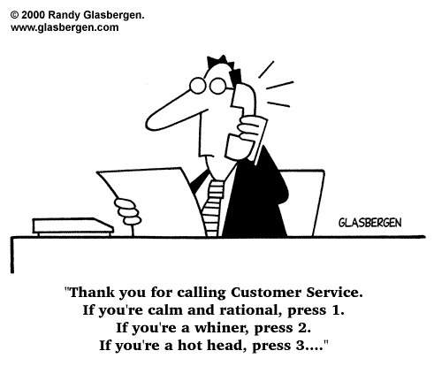

Thank you,
Questions?

